Slide 1
Brindle & Herbie’s Big Adventure: Life Story Work Template
A creative framework for capturing life journeys
Notes:
---

Slide 2
Introduction
Notes:
Introduction to Life Story Work, Practical Guidance for Social Workers, Age-Appropriate Language Examples

Slide 3
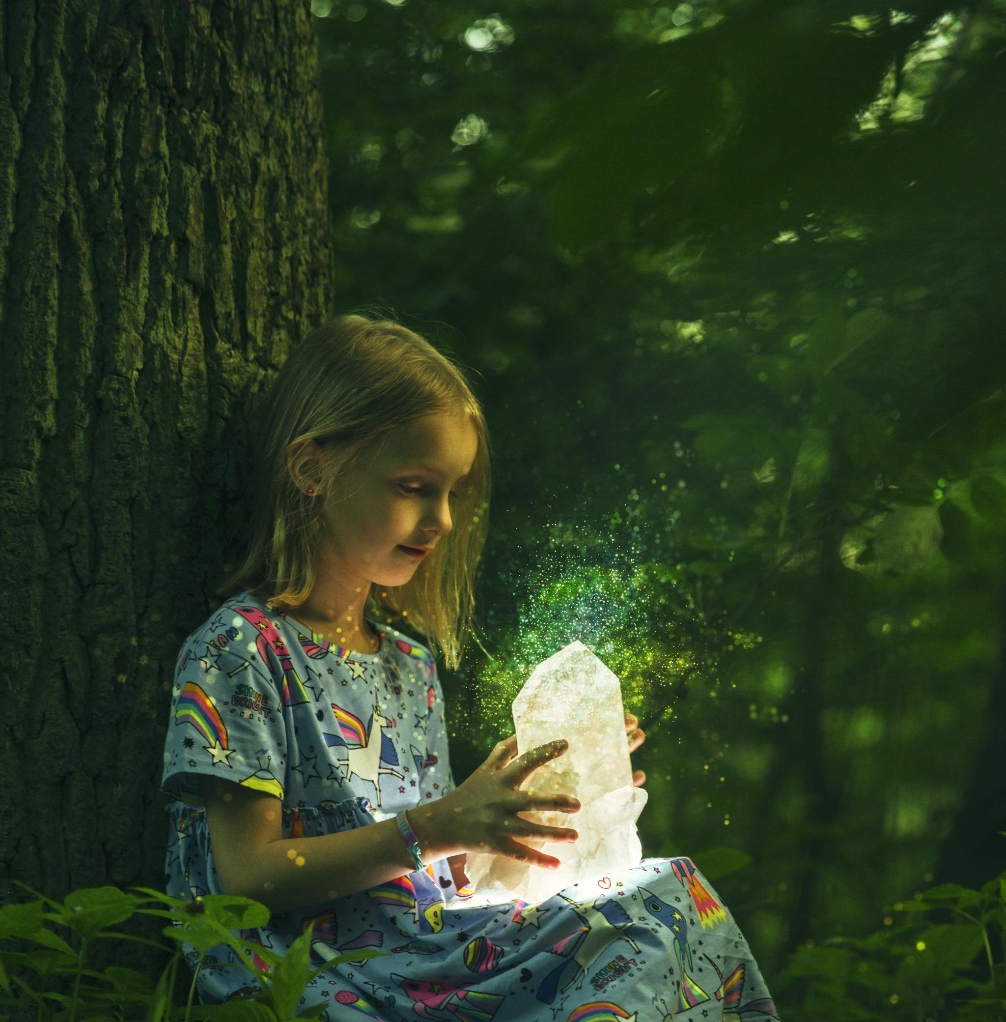
Introduction to Life Story Work
Purpose of Life Story Work
  Life Story Work helps children understand their past and envision a hopeful future through storytelling and reflection.
Supporting Emotional Resilience
  Provides a compassionate framework for carers and social workers to validate emotions and build children’s resilience.
Fostering Connections
  Life Story Work fosters meaningful connections and trust between children and their carers or adoptive parents.
Notes:
Life Story Work is a therapeutic and developmental tool designed to help children in care understand their personal history, embrace their present circumstances, and envision a hopeful future. It provides a structured way for children to explore their identity, relationships, and experiences through storytelling, imagery, and reflection. For social workers, carers, and adoptive parents, Life Story Work offers a compassionate framework to support children’s emotional resilience and sense of belonging. This presentation introduces the purpose and benefits of Life Story Work, emphasizing its role in building trust, validating emotions, and fostering meaningful connections.

Slide 4

Practical Guidance for Social Workers
Use Age-Appropriate Language
  Employ language and visuals suitable for the child’s age to enhance understanding and comfort.
Encourage Creative Expression
  Promote creativity through drawings, photos, and storytelling to help children express their feelings.
Create Safe Environment
  Establish a supportive space where children feel safe to share and express themselves freely.
Respect Emotional Readiness
  Be attentive to the child’s emotional state and progress sessions at a comfortable pace.
Notes:
Social workers play a vital role in facilitating Life Story Work. Practical tips include using age-appropriate language and visuals, encouraging creativity through drawings and photos, validating children's feelings, and involving carers in storytelling activities. It’s important to create a safe and supportive environment where children feel comfortable expressing themselves. Social workers should also be mindful of the child’s emotional readiness and pace the sessions accordingly. This slide provides actionable advice to help professionals navigate common challenges and ensure the process is both therapeutic and empowering.

Slide 5
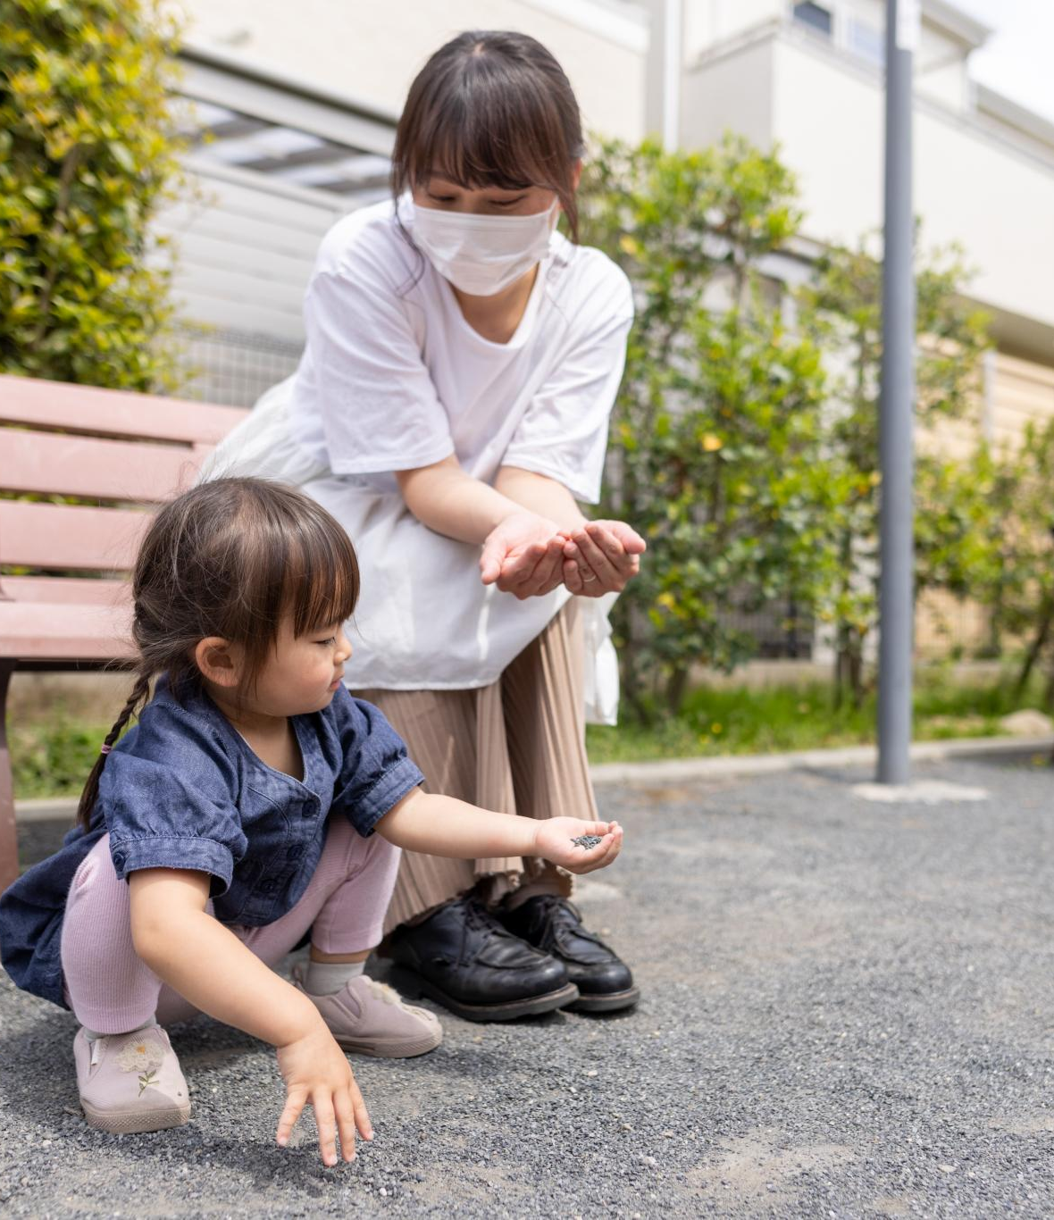
Age-Appropriate Language Examples
Compassionate Language Use
  Using gentle and caring phrases helps children understand difficult truths without fear or distress.
Reframing Difficult Topics
  Replacing harsh words with nurturing explanations supports children’s emotional safety and dignity.
Preserving Child’s Security
  Language choice aims to maintain a child’s sense of security while communicating honestly.
Notes:
Using sensitive and age-appropriate language is crucial in Life Story Work. For example, instead of saying 'Your parents abandoned you,' a more compassionate phrase would be 'Your parents couldn’t look after you because they were poorly.' Similarly, replacing 'You were taken away' with 'We wanted to make sure you were safe and cared for' helps maintain a nurturing tone. These examples guide social workers in framing difficult topics in a way that is understandable and emotionally safe for young children. The goal is to communicate truthfully while preserving the child’s sense of security and dignity.

Slide 6
Case Study
Notes:
Case Study: Herbie & Brindle

Slide 7

Case Study: Herbie & Brindle
Foster Care Introduction
  Herbie and Brindle were placed in foster care where new positive experiences like baking and fishing were introduced.
Meeting Adoptive Family
  The brothers met their adoptive family and celebrated their new beginning with balloons and cake, symbolizing hope.
Life Story Work Impact
  Structured storytelling and supportive relationships help children process trauma, build identity, and feel valued.
Notes:
Herbie and Brindle’s story illustrates the transformative power of Life Story Work. After their parents were hospitalized due to an accident, the brothers were placed in foster care. Their foster carers introduced them to baking and fishing, creating new positive memories. Eventually, Herbie and Brindle met their adoptive family and celebrated their new beginning with balloons and cake. This case study highlights how structured storytelling and supportive relationships can help children process trauma, build identity, and feel valued. It serves as a practical example for social workers to understand the emotional journey and milestones involved in Life Story Work.

Slide 8
Interactive Resources
Notes:
Accessing Templates and Tutorials

Slide 9

Accessing Templates and Tutorials
Interactive Digital Resources
  QR codes and online links provide quick access to interactive resources supporting social workers and carers.
Downloadable Templates
  Templates for Life Story Work are available for download to assist with structured storytelling activities.
Video Tutorials
  Step-by-step video tutorials demonstrate best practices for effective Life Story Work implementation.
Online Resource Library
  A comprehensive online library hosts various materials to enhance professional practice and engagement.
Notes:
To support social workers and carers, interactive resources are available via QR codes and online links. These include downloadable templates for Life Story Work, video tutorials demonstrating best practices, and access to a resource library hosted on ailifestorywork.co.uk. These tools are designed to make implementation easier and more effective, offering step-by-step guidance and examples. By integrating digital resources into the presentation, professionals can quickly access materials that enhance their practice and provide children with engaging and personalized storytelling experiences.

Slide 10
Life Story Sections
Notes:
Who Am I?, My Early Days, My Birth Family, My Foster Family, My Adoption Story, My Life Now, My Feelings, My Memory Box, My Future

Slide 11
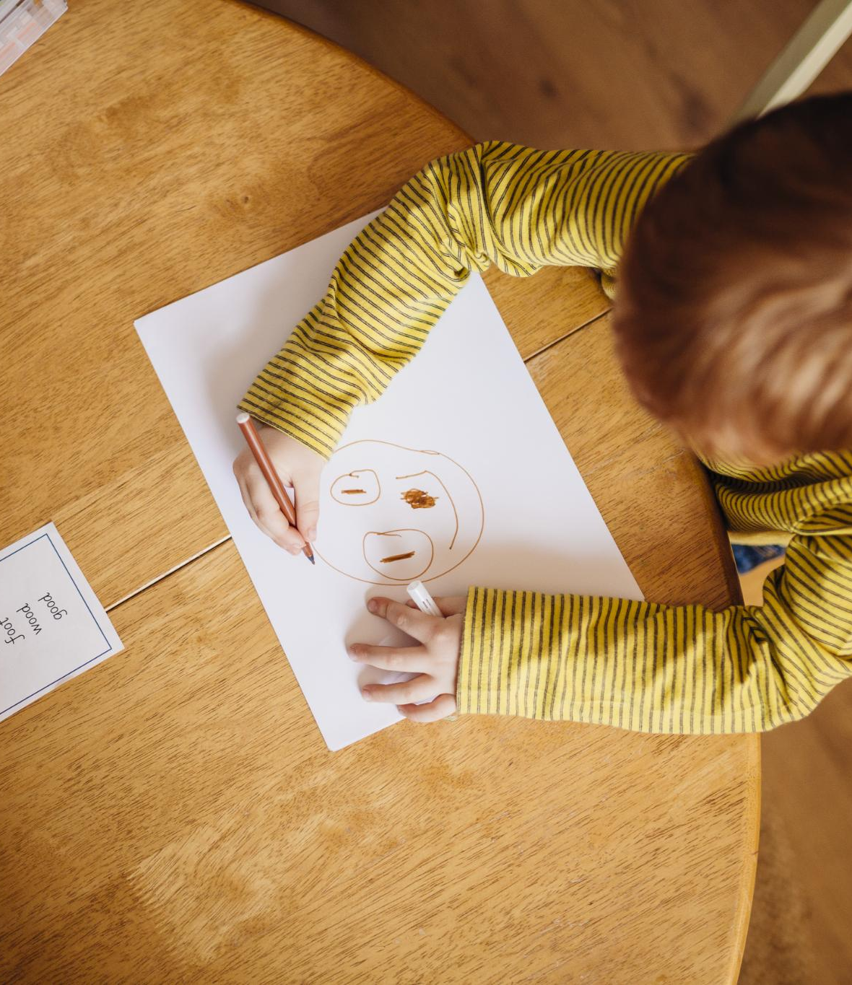
Who Am I?
Exploring Personal Identity
  Children reflect on their name, birth date, personality traits, and favorite things to understand themselves better.
Using Prompts and Images
  Social workers use prompts and images to encourage children to share their likes, dislikes, and personal stories freely.
Guided Storytelling Tools
  Placeholders for descriptions, example images, and video ideas help structure the storytelling and identity sharing process.
Notes:
This section helps children explore their identity, including their name, birth date, personality traits, and favorite things. It sets the foundation for understanding who they are and what makes them unique. Social workers can use prompts and images to encourage children to share their likes, dislikes, and personal stories. This slide includes placeholders for descriptions, example images, and video ideas to guide the storytelling process.

Slide 12
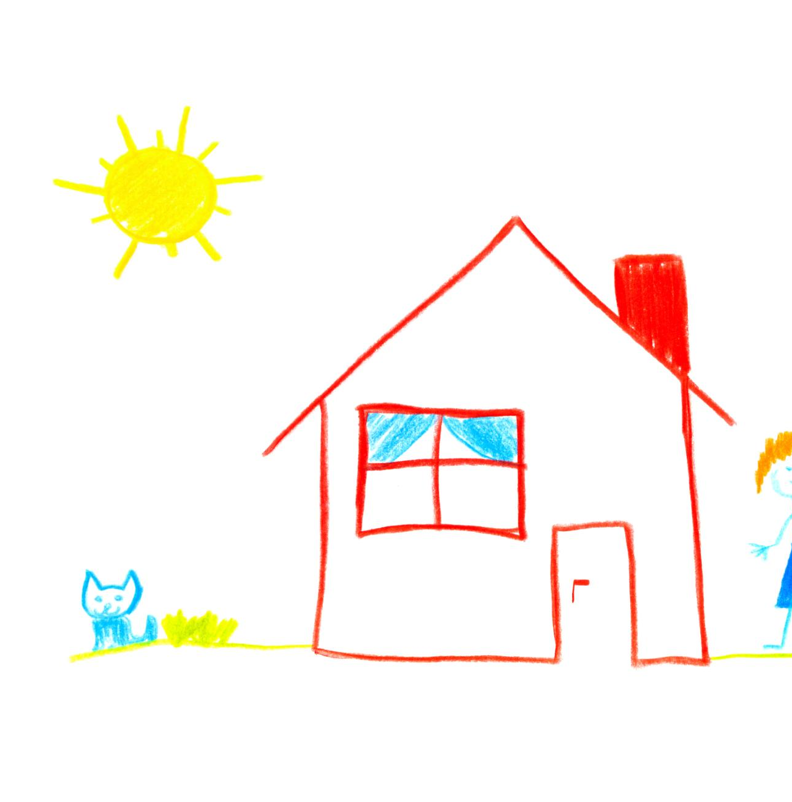
My Early Days
Early Environment
  Children recall where they lived during their early years to build context for their life story.
Caregivers and Support
  Remembering who cared for them helps children connect with early relationships and emotional support.
Key Milestones
  Recognizing early life milestones aids children in understanding their growth and development.
Notes:
Children reflect on their early experiences, including where they lived, who cared for them, and key milestones. This section helps build continuity and context for their life journey. Social workers can use gentle prompts and visuals to help children recall early memories and understand their beginnings. The slide includes placeholders for descriptions, example images, and video ideas.

Slide 13
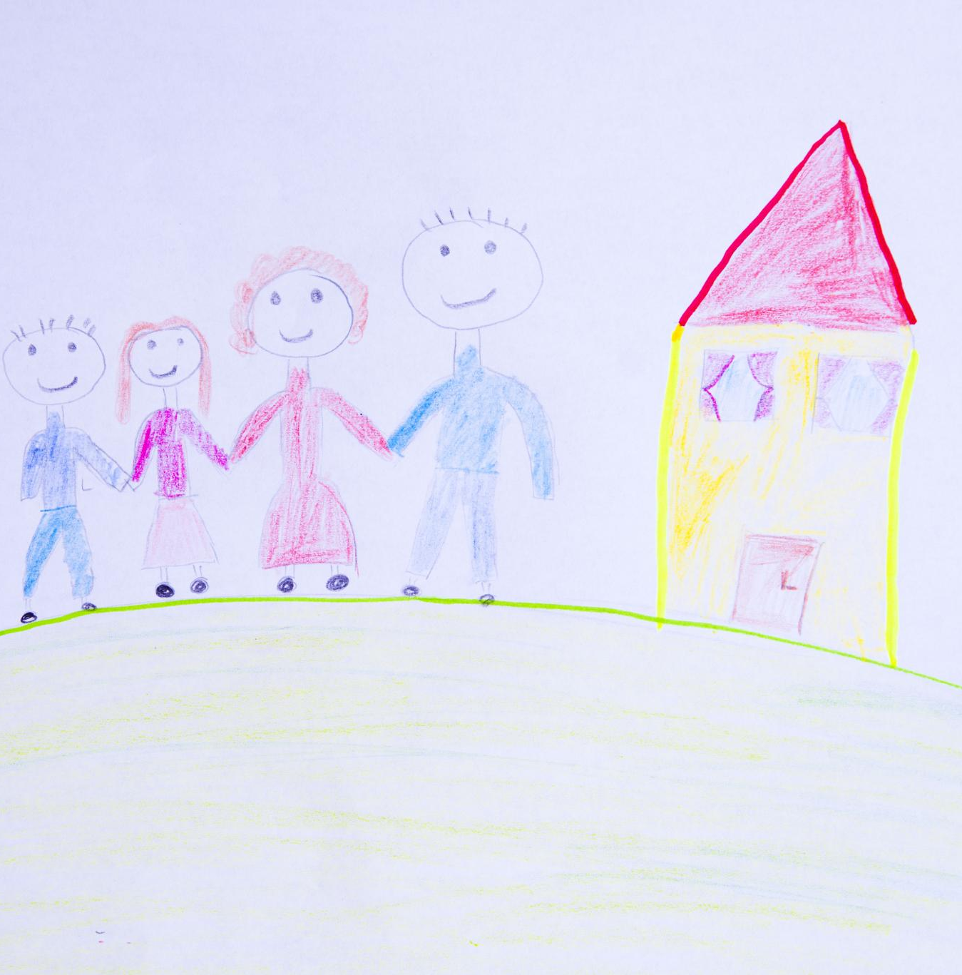
My Birth Family
Age-Appropriate Information
  Provide sensitive and honest details about the birth family that are suitable to the child's age and understanding.
Emotional Safety and Support
  Ensure the child feels safe and supported while learning about their birth family to foster trust and comfort.
Use of Visual Aids
  Utilize drawings, letters, and photos to help children connect emotionally and visually with their birth family history.
Notes:
This section provides age-appropriate information about the child’s birth parents and family. It’s important to approach this with sensitivity and honesty, ensuring the child feels safe and supported. Social workers can use drawings, letters, and photos to help children connect with their birth family history. The slide includes placeholders for descriptions, example images, and video ideas.

Slide 14

My Foster Family
Positive Foster Memories
  Foster children share joyful memories and routines that strengthen bonds with their carers.
Shared Activities
  Activities like baking and fishing promote connection and lasting positive experiences in foster care.
Celebrating Relationships
  Highlighting the nurturing relationships formed between foster children and their carers.
Notes:
Children share memories and routines from their time in foster care. This section highlights the positive experiences and relationships formed during this period. Social workers can include stories about activities like baking, fishing, and outings to help children remember and appreciate their foster carers. The slide includes placeholders for descriptions, example images, and video ideas.

Slide 15

My Adoption Story
Meeting the Adoptive Family
  The child’s introduction to their adoptive family marks the beginning of a new, loving chapter in their life.
Celebrating Adoption Milestones
  Highlighting key moments in the adoption journey celebrates the child’s new permanent home and sense of belonging.
Using Stories and Traditions
  Incorporating family traditions and celebration stories helps children feel secure and cherished in their new home.
Notes:
This section explains how the child met their adoptive family and the key moments of their adoption journey. It celebrates the transition to a permanent, loving home. Social workers can use photos, celebration stories, and family traditions to help children feel secure and cherished. The slide includes placeholders for descriptions, example images, and video ideas.

Slide 16

My Life Now
Daily Routines
  Children describe their regular daily activities that provide structure and stability in their lives.
Hobbies and Interests
  Encouraging children to share their hobbies helps reveal their passions and sources of joy.
Social Relationships
  Highlighting friendships and supportive relationships fosters a sense of connection and belonging.
School Experiences
  Sharing school experiences helps children reflect on their learning and social environment.
Notes:
Children describe their current routines, hobbies, relationships, and school experiences. This section helps them feel grounded and recognize the stability in their lives. Social workers can encourage children to share what they enjoy and who they spend time with. The slide includes placeholders for descriptions, example images, and video ideas.

Slide 17

My Feelings
Emotional Expression Tools
  Feeling faces, drawings, and stories help children express and understand their emotions safely.
Therapeutic Space
  Social workers create a supportive environment for children’s emotional exploration and validation.
Creative Reflection
  Using stories and videos encourages children to reflect on and share their feelings creatively.
Notes:
This section allows children to express their emotions and reflections. Using feeling faces, drawings, and stories, social workers can help children identify and understand their feelings. It’s a therapeutic space for emotional exploration and validation. The slide includes placeholders for descriptions, example images, and video ideas.

Slide 18
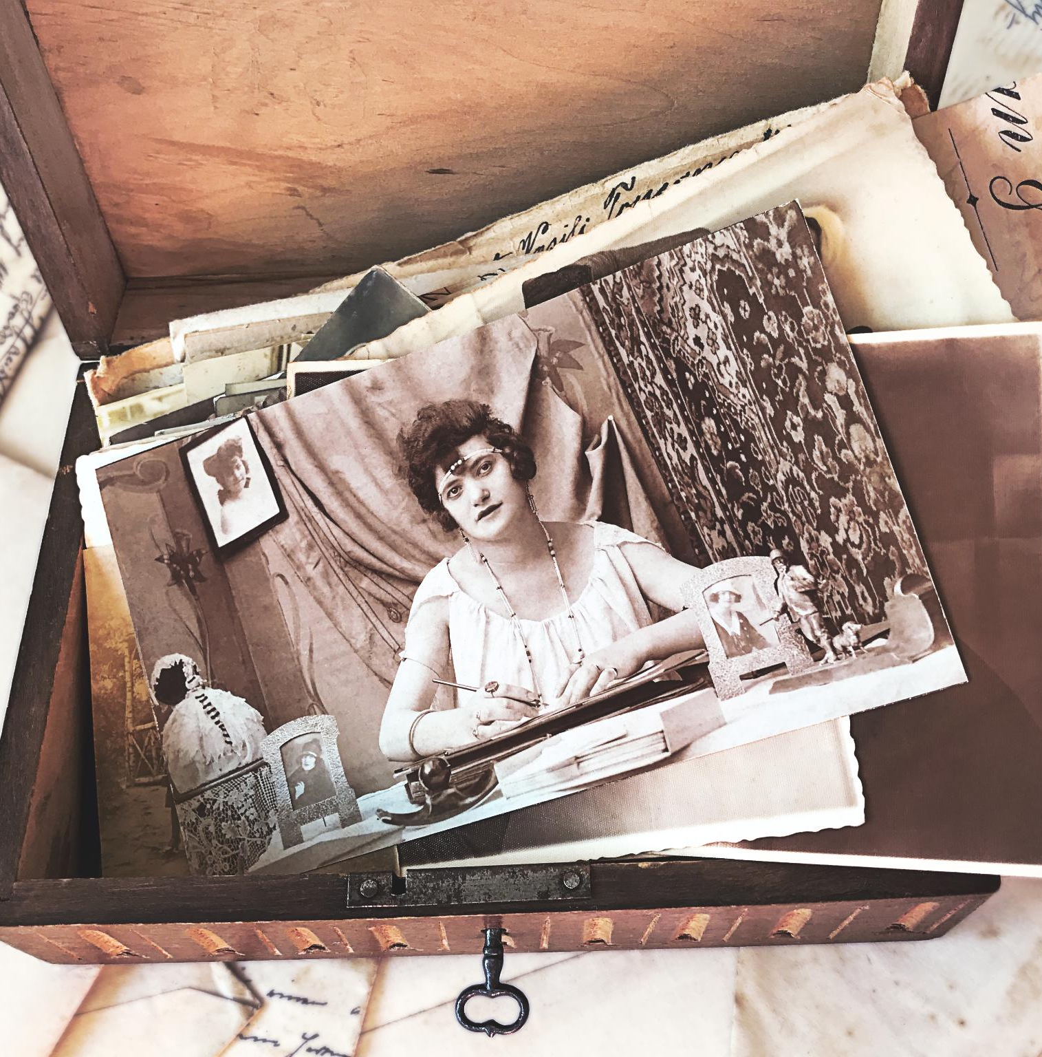
My Memory Box
Keepsakes and Memorabilia
  Keepsakes such as photos, letters, and certificates preserve important memories from different life stages.
Emotional Connection
  Memory boxes provide children with a tangible connection to their personal journey and past experiences.
Guided Selection
  Social workers assist children in choosing meaningful items and explaining their personal importance.
Notes:
Children list keepsakes, photos, letters, and certificates from each life stage. This section helps preserve important memories and provides a tangible connection to their journey. Social workers can guide children in selecting meaningful items and explaining their significance. The slide includes placeholders for descriptions, example images, and video ideas.

Slide 19

My Future
Children's Hopes and Dreams
  Children express their hopes and dreams for the future, reflecting optimism and personal goals.
Support from Social Workers
  Social workers provide guidance and support to help children visualize and achieve their aspirations.
Encouraging Optimism
  The section fosters optimism and goal-setting through shared messages from adoptive parents and social workers.
Notes:
Children share their hopes, dreams, and messages from adoptive parents and social workers. This section encourages optimism and goal-setting. Social workers can help children visualize their future and feel supported in their aspirations. The slide includes placeholders for descriptions, example images, and video ideas.

Slide 20
Appendix
Notes:
Full Example Image Index (Landscape)

Slide 21

Full Example Image Index (Landscape)
Comprehensive Image Prompts
  The appendix contains 70 prompts helping social workers select images for varied life story scenarios.
Support for Storytelling
  Prompts enhance the emotional depth and visual appeal of children's life stories for effective support.
Guidance for Image Selection
  Social workers use prompts to guide image choice or AI generation to enrich storytelling visuals.
Notes:
This appendix lists all 70 example image prompts grouped by section. Each prompt is designed to help social workers visualize and generate relevant images for Life Story Work. The prompts cover a wide range of scenarios, from playful moments to emotional reflections, ensuring comprehensive support for storytelling. Social workers can use these prompts to guide image selection or AI generation, enhancing the visual appeal and emotional resonance of the child’s life story.

