Slide 1
Brindle & Herbie’s Big Adventure: Life Story Work Presentation for Social Workers
Enhancing social work through meaningful life story sharing
Notes:
---

Slide 2
Introduction to Life Story Work
Notes:
Purpose of Life Story Work, Practical Tips for Social Workers

Slide 3

Purpose of Life Story Work
Understanding Personal History
  Life Story Work helps children explore and understand their personal histories and identities.
Emotional Processing and Resilience
  It provides a safe space for children to process emotions and build resilience after family separation.
Building Coherent Narratives
  Social workers guide children to develop coherent life stories that validate their experiences and foster belonging.
Notes:
Life Story Work is a therapeutic and developmental approach used to help children in care understand their personal history, identity, and journey. It provides a structured way for children to explore their past, make sense of their present, and envision a hopeful future. For children like Herbie and Brindle, who have experienced separation from their birth families, Life Story Work offers a safe space to process emotions, build self-esteem, and foster resilience. Through storytelling, creative activities, and guided reflection, social workers can support children in developing a coherent narrative that validates their experiences and strengthens their sense of belonging.

Slide 4

Practical Tips for Social Workers
Use Age-Appropriate Language
  Communicate in simple, relatable terms that children can easily understand and connect with.
Create Safe Supportive Environment
  Foster trust and positivity by maintaining a safe, encouraging space for children to express themselves.
Use Engaging Tools
  Incorporate memory boxes, storybooks, and visual prompts to boost children's participation and creativity.
Navigate Sensitive Topics
  Approach difficult subjects with empathy and professionalism to protect the child's emotional wellbeing.
Notes:
Social workers play a crucial role in facilitating Life Story Work. To ensure effectiveness, it is important to use age-appropriate language that children can understand and relate to. Sessions should be kept short and positive, focusing on building trust and encouraging creativity. Validating children's feelings and experiences is essential, as is creating a safe and supportive environment. Tools such as memory boxes, storybooks, and visual prompts can enhance engagement. Social workers should also be prepared to navigate sensitive topics with empathy and professionalism, ensuring that the child's emotional wellbeing remains the priority throughout the process.

Slide 5
Case Study and Resources
Notes:
Case Study: Herbie & Brindle, Resources & Templates

Slide 6
Case Study: Herbie & Brindle
Exploring Early Memories
Life Story Work helps children explore early memories and understand reasons for their foster placement.
Building Family Connections
Activities like creating memory boxes and attending events strengthen bonds with foster and adoptive families.
Fostering Emotional Healing
Life Story Work fosters emotional healing and helps children develop a stronger sense of identity and security.
Notes:
Herbie and Brindle are fictional siblings who entered foster care after their birth parents were hospitalized due to a serious accident. Through Life Story Work, they were able to explore their early memories, understand the reasons for their placement, and build connections with their foster and adoptive families. Activities such as drawing family trees, creating memory boxes, and attending community events helped them feel secure and valued. This case study illustrates how Life Story Work can transform a child's experience of care, fostering emotional healing and a stronger sense of identity.

Slide 7

Resources & Templates
Available Support Resources
  Social workers have access to downloadable templates, guides, and video tutorials to support Life Story Work.
Practical Tools for Sessions
  Resources help structure sessions, document progress, and engage children meaningfully during Life Story Work.
Easy Resource Access
  QR codes in the presentation provide direct links to resources, enhancing accessibility and integration.
Enhanced Child-Centered Practice
  Using these resources improves the quality and consistency of Life Story Work, making it more impactful for children.
Notes:
Social workers can access a range of resources to support Life Story Work, including downloadable templates, instructional guides, and video tutorials. These materials provide practical tools for structuring sessions, documenting progress, and engaging children in meaningful activities. QR codes embedded in the presentation link directly to these resources, ensuring easy access and integration into daily practice. By utilizing these tools, social workers can enhance the quality and consistency of Life Story Work, making it more impactful and child-centered.

Slide 8
Life Story Sections
Notes:
Who Am I?, My Early Days, My Birth Family, My Foster Family, My Adoption Story, My Life Now, My Feelings, My Memory Box, My Future

Slide 9
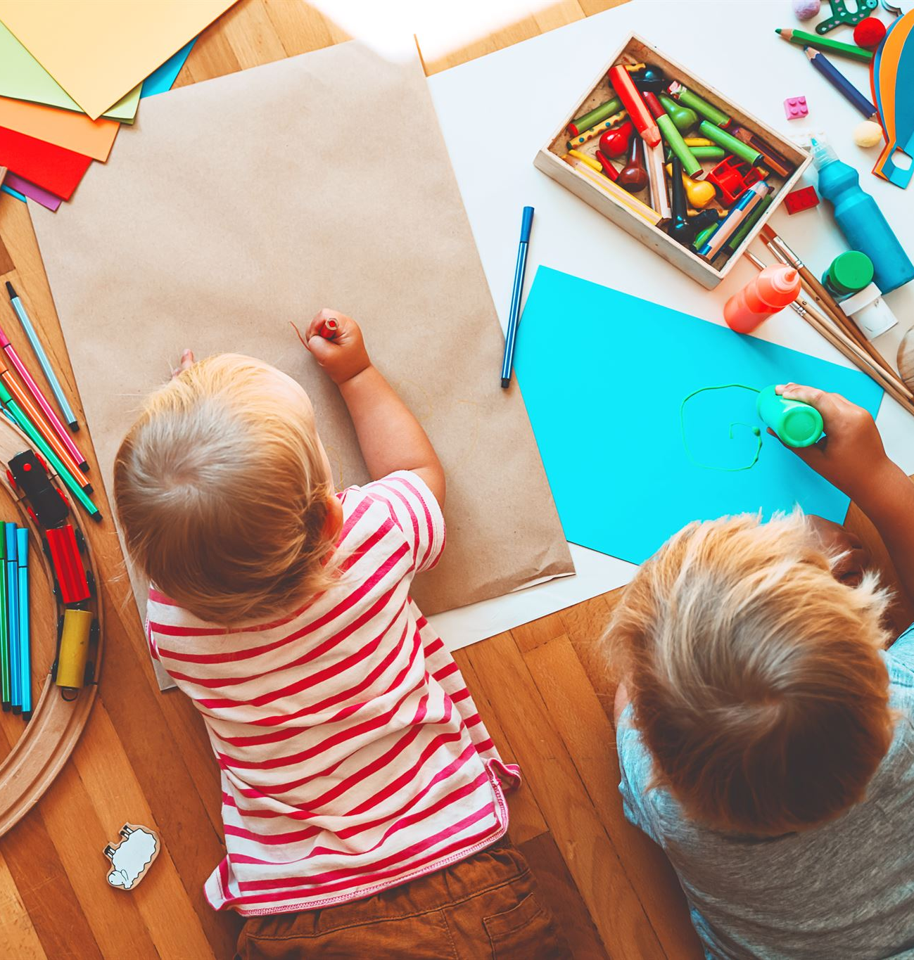
Who Am I?
Child Identity Elements
  Focus on child's name, birth date, personality traits, and favourite things to build self-awareness.
Creative Activities
  Engage children with self-portraits, listing favourite toys or foods, and storytelling to celebrate uniqueness.
Personal Interests
  Highlight personal interests like love for dinosaurs and painting to express individuality and creativity.
Notes:
This section focuses on the child's identity, including their name, birth date, personality traits, and favourite things. It helps children affirm who they are and celebrate their uniqueness. Activities may include drawing self-portraits, listing favourite toys or foods, and sharing stories about their interests. For Herbie and Brindle, this might involve describing their love for dinosaurs and painting, and capturing moments of play and creativity.

Slide 10
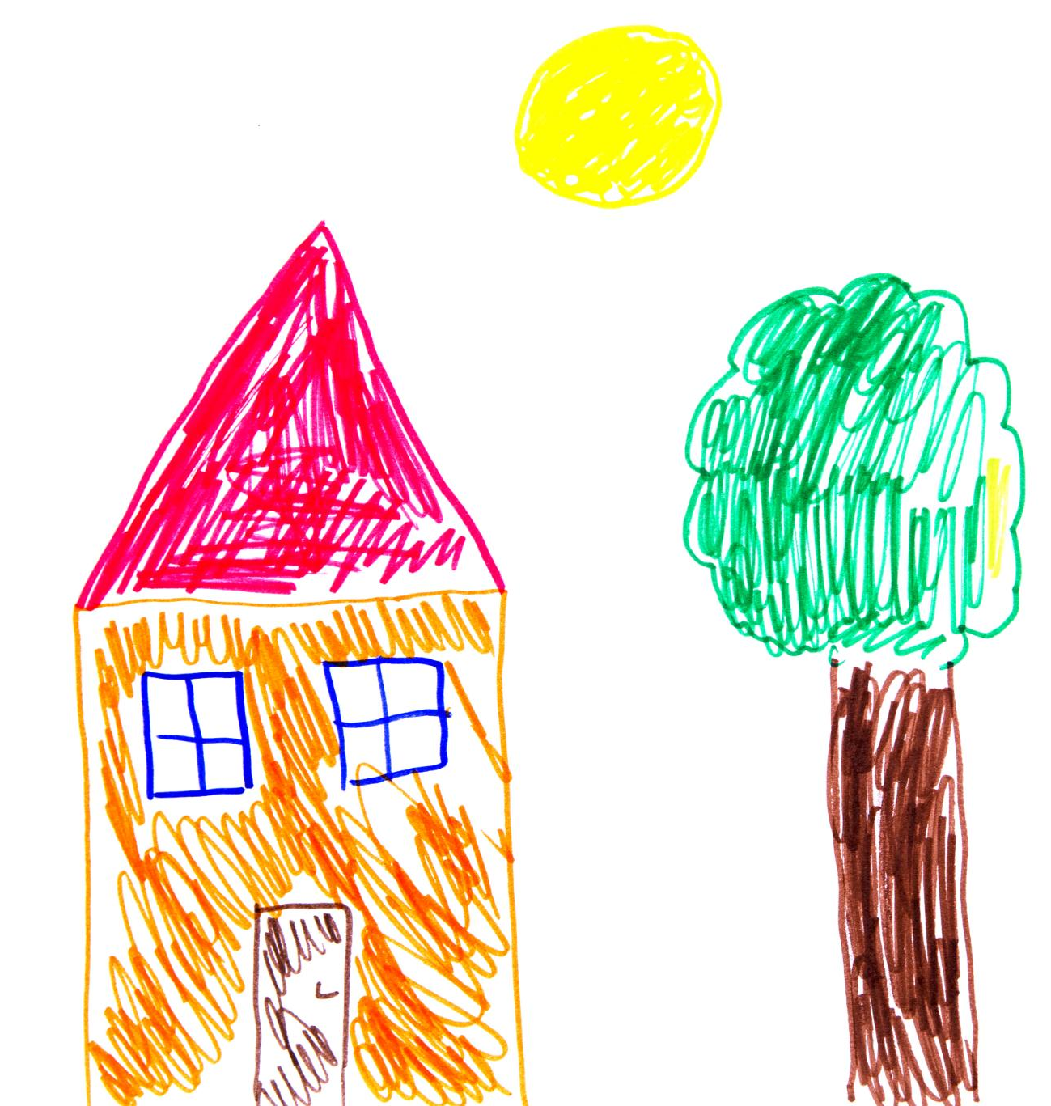
My Early Days
Early Life Context
  Documenting where the child lived and key caregivers provides meaningful context for their early journey.
Developmental Milestones
  Highlighting important developmental milestones helps understand the child's early growth and progress.
Early Memories and Activities
  Recollecting early memories like playing in the garden and bedtime stories fosters emotional connection and reflection.
Notes:
This section documents the child's early life, including where they lived, key caregivers, and developmental milestones. It provides context for their journey and helps them understand their beginnings. Activities may include creating timelines, mapping homes, and recalling early memories. Herbie and Brindle might reflect on their first home in Dorchester, playing in the garden, and bedtime stories with their parents.

Slide 11
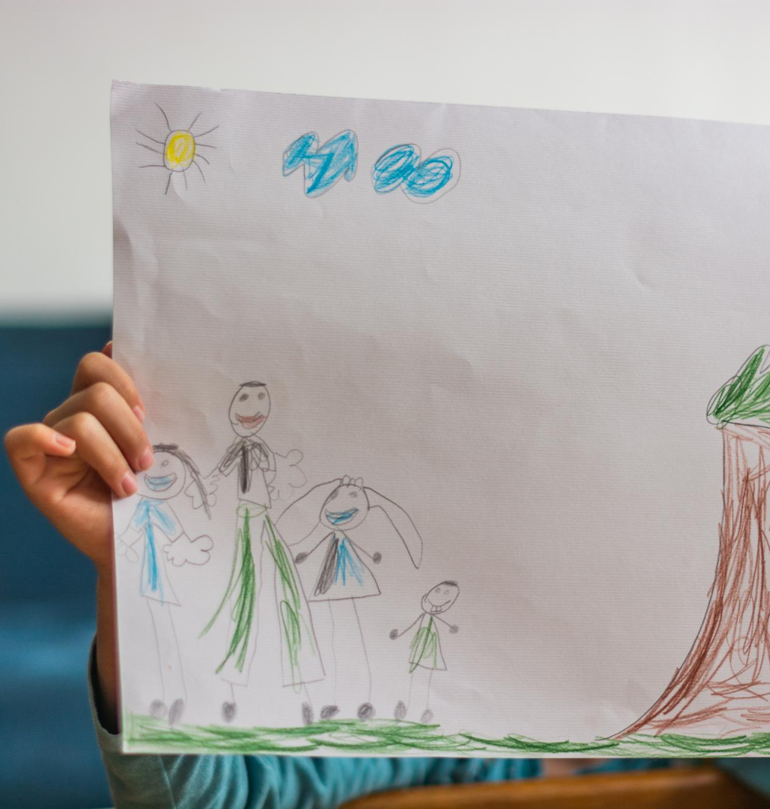
My Birth Family
Understanding Origins
  Providing gentle, age-appropriate information helps children connect with their birth family and heritage.
Creative Expression Activities
  Activities like drawing family trees and storytelling support emotional expression and understanding of family history.
Emotional Processing
  Expressing feelings about family events through art and storytelling helps children process emotions healthily.
Notes:
This section offers gentle, age-appropriate information about the child's birth family. It helps children understand their origins and maintain a connection to their heritage. Activities may include drawing family trees, writing letters, and sharing photos. For Herbie and Brindle, this might involve learning about their parents' accident and expressing feelings through art and storytelling.

Slide 12
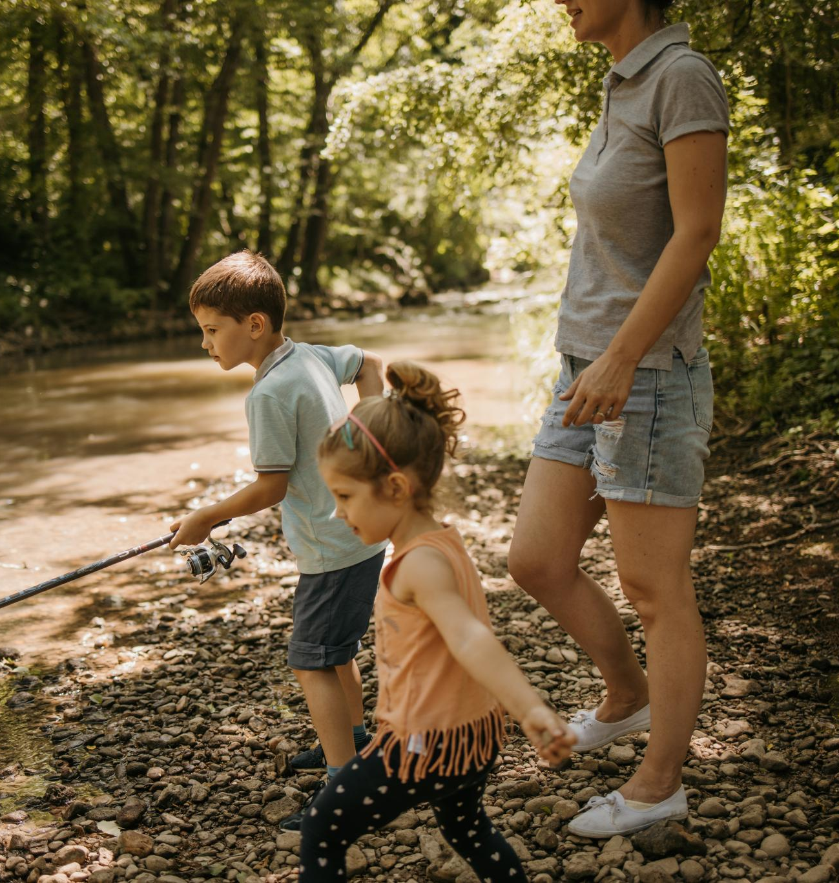
My Foster Family
Supportive Foster Care
  Foster carers provide essential support and care during a child's transitional period, fostering stability and trust.
Shared Activities
  Activities like fishing trips, baking, and fire station visits create memorable experiences and strengthen family bonds.
Creative Expression
  Photo collages and journaling help children document their experiences and celebrate milestones with their foster family.
Notes:
This section highlights the child's experiences with foster carers, including routines, special memories, and relationships. It acknowledges the support and care provided during a transitional period. Activities may include photo collages, journaling, and celebrating milestones. Herbie and Brindle might recall fishing trips, baking sessions, and attending a fire station open day with their foster family.

Slide 13
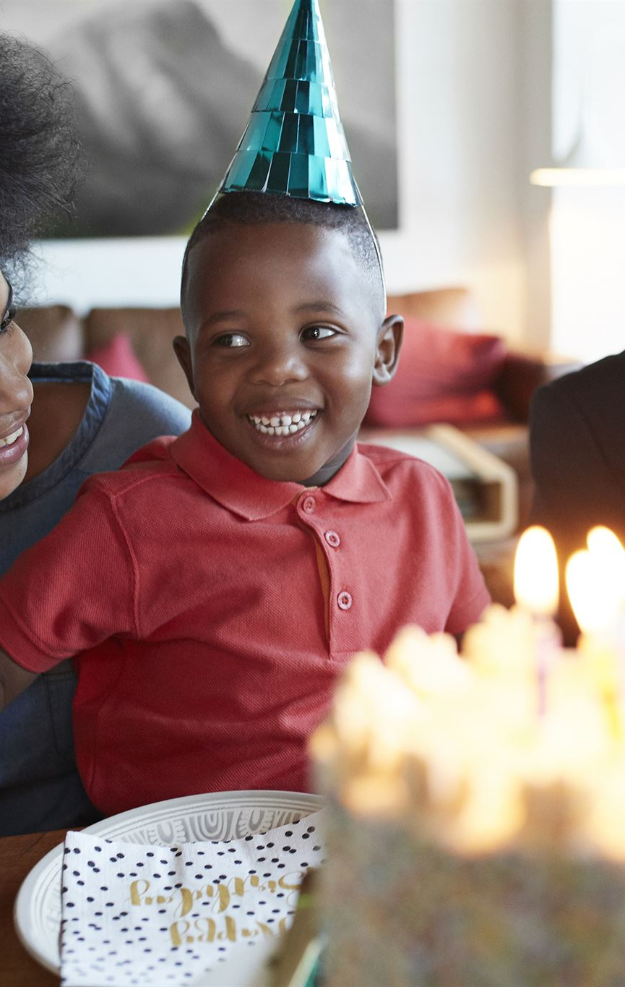
My Adoption Story
Meeting Adoptive Parents
  Describes the special moment when the child first met their adoptive parents, marking the start of a lifelong bond.
Celebrating Adoption Day
  Focuses on the celebration of adoption day with activities like welcome parties featuring balloons and cake.
Family Traditions
  Highlights sharing and creating family traditions that reinforce feelings of belonging and permanency.
Documenting Memories
  Encourages documenting key moments such as the first family photo and creating welcome books.
Notes:
This section explains how the child met their adoptive parents and key moments in their adoption journey. It celebrates the formation of a permanent family and reinforces feelings of belonging. Activities may include creating welcome books, documenting adoption day, and sharing family traditions. Herbie and Brindle might describe their welcome party with balloons and cake, and their first family photo.

Slide 14
My Life Now
Daily Routines
Daily routines provide structure and a sense of stability, helping children recognize growth and consistency in their lives.
Hobbies and Play
Engaging in hobbies like bike riding and football encourages physical activity and social interaction among children.
Relationships and Pets
Friendship maps and sharing time with pets like dogs help nurture emotional bonds and social skills in children.
Notes:
This section captures the child's current life, including routines, hobbies, relationships, and school experiences. It helps children recognize stability and growth. Activities may include daily schedules, friendship maps, and hobby scrapbooks. Herbie and Brindle might share stories about riding bikes, playing football, and spending time with their pet dog Max.

Slide 15

My Feelings
Encouraging Emotional Expression
  Children are encouraged to express emotions to build emotional literacy and improve coping skills.
Creative Emotional Activities
  Activities such as drawing emotions help children reflect and communicate their feelings creatively.
Exploring Key Emotions
  Exploration of happiness, sadness, and bravery supports children's understanding and management of feelings.
Notes:
This section encourages children to express their emotions and reflections. It supports emotional literacy and coping strategies. Activities may include using feeling faces, drawing emotions, and discussing experiences. Herbie and Brindle might explore feelings of happiness, sadness, and bravery through creative exercises and guided conversations.

Slide 16

My Memory Box
Types of Keepsakes
  Keepsakes include photos, letters, certificates, and personal items that capture each life stage.
Memory Preservation Activities
  Activities like decorating boxes, labeling items, and storytelling help preserve memories effectively.
Personalized Mementos
  Personal items like baby shoes, birthday cards, and teddy bears create unique connections to family history.
Notes:
This section lists keepsakes, photos, letters, and certificates from each life stage. It provides tangible connections to the child's journey and supports memory preservation. Activities may include decorating boxes, labeling items, and storytelling. Herbie and Brindle might include baby shoes, birthday cards, and a teddy bear from their birth family.

Slide 17

My Future
Hopes and Dreams
  This section encourages children to express their hopes and dreams through creative activities like vision boards and dream journals.
Supportive Family Messages
  Adoptive parents and social workers provide positive messages that inspire optimism and goal-setting in children.
Future Aspirations
  Herbie and Brindle imagine futures as a firefighter and an artist, motivated by their loving family's support.
Notes:
This section includes hopes, dreams, and messages from adoptive parents and social workers. It fosters optimism and goal-setting. Activities may include vision boards, dream journals, and letters to future selves. Herbie and Brindle might dream of becoming a firefighter and an artist, supported by their loving family.

Slide 18
Appendix
Notes:
Example Image Prompts

Slide 19

Example Image Prompts
Comprehensive Image Prompts
  Includes 70 example prompts grouped by section to guide visual storytelling in Life Story Work.
Child Narrative Alignment
  Prompts are created to evoke warmth and authenticity, connecting visuals to the child's story.
Notes:
This appendix provides a comprehensive list of 70 example image prompts grouped by section. These prompts guide the selection or generation of visuals that align with each part of the Life Story Work. They include scenes such as Herbie and Brindle playing with dinosaurs, attending a birthday party, and planting a future tree. The prompts are designed to evoke warmth, authenticity, and relevance to the child's narrative.

