Slide 1

Brindle & Herbie’s Big Adventure: Life Story Work Presentation for Social Workers
Exploring meaningful stories to support social work practice
Notes:
---

Slide 2
Introduction
Notes:
Purpose of Life Story Work, Practical Tips for Social Workers

Slide 3

Purpose of Life Story Work
Therapeutic Exploration
  Life Story Work helps children in care understand their past and embrace their present through therapeutic storytelling.
Identity and Relationships
  It enables children to explore their identity and relationships by reflecting on their experiences and memories.
Support for Social Workers
  Life Story Work offers social workers a meaningful way to connect with children and support emotional wellbeing.
Illustrative Case Study
  The journey of siblings Herbie and Brindle demonstrates the practical application of Life Story Work in care and adoption.
Notes:
Life Story Work is a therapeutic and developmental tool used to help children in care understand their past, embrace their present, and dream about their future. It provides a structured way for children to explore their identity, relationships, and experiences through storytelling, imagery, and reflection. For social workers, it offers a meaningful way to connect with children and support their emotional wellbeing. This presentation introduces the fictional journey of Herbie and Brindle, two siblings navigating care and adoption, to illustrate how Life Story Work can be applied effectively.

Slide 4
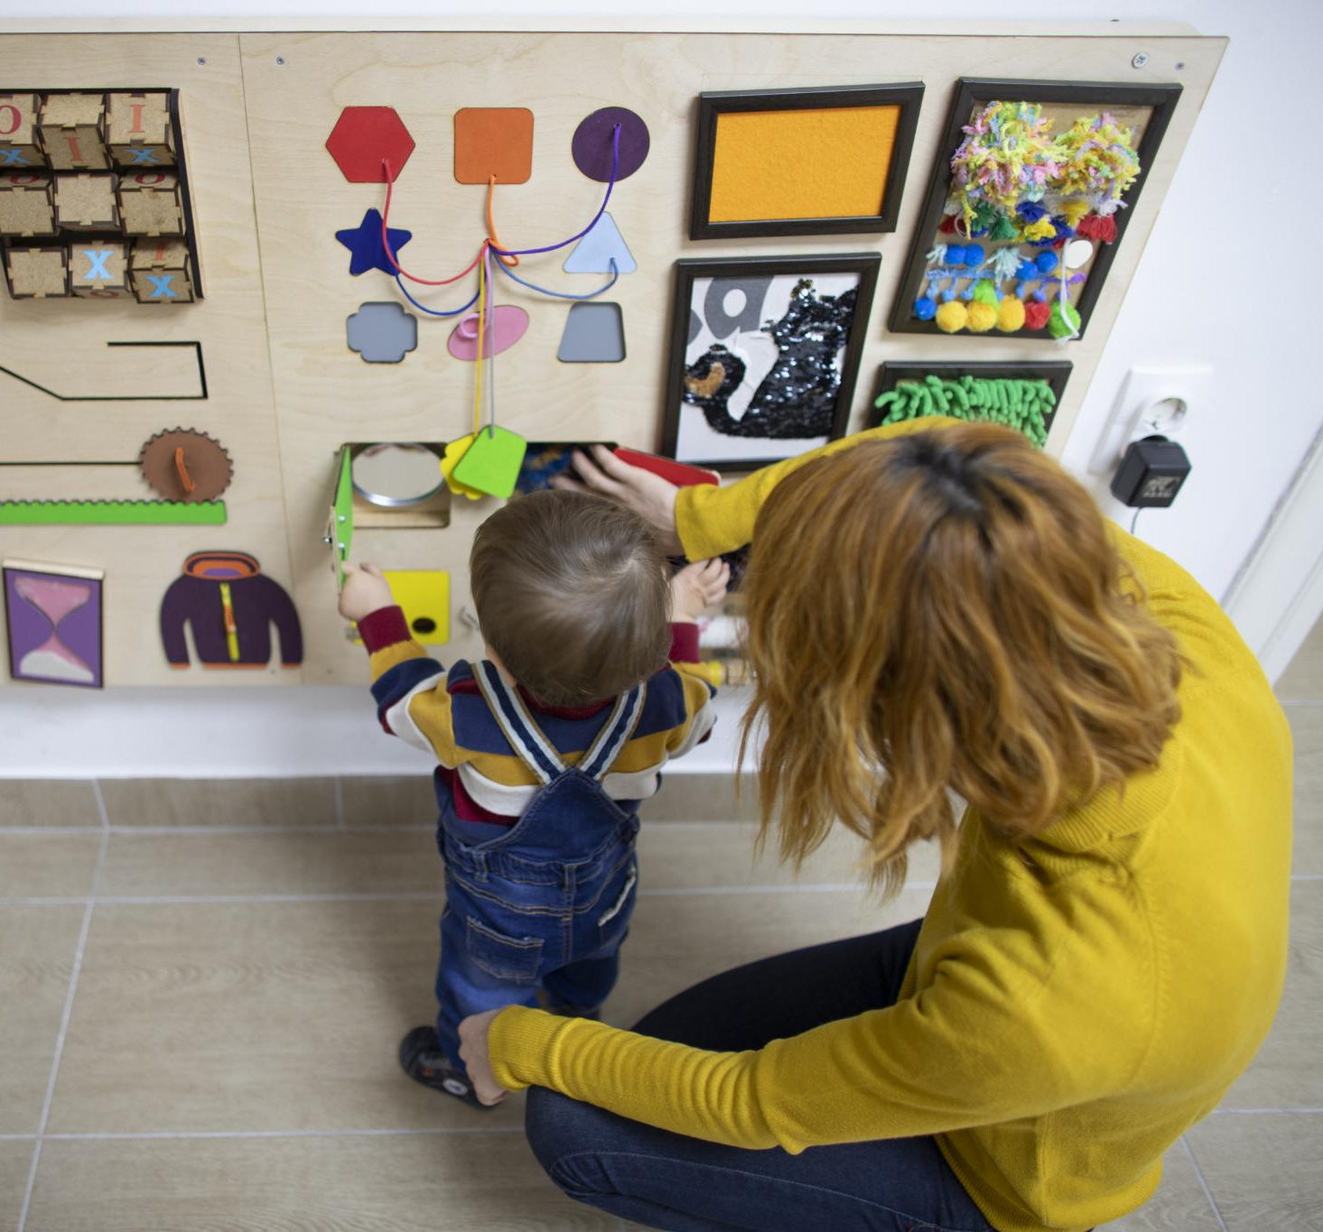
Practical Tips for Social Workers
Child-Centered Communication
  Use age-appropriate language and encourage creativity through play and drawings to engage children effectively.
Safe and Trusting Environment
  Create a supportive space where children feel comfortable sharing and validate their feelings throughout sessions.
Use of Visual and Interactive Aids
  Incorporate memory boxes, visual aids, and interactive elements like QR codes to enhance children's engagement.
Tailored Emotional Support
  Be mindful of each child's emotional readiness and adapt approaches according to their developmental stage.
Notes:
Social workers play a vital role in facilitating Life Story Work. Key tips include using age-appropriate language, encouraging creativity through drawings and play, validating children's feelings, and keeping sessions short and positive. It's important to create a safe and trusting environment where children feel comfortable sharing. Incorporating visual aids, memory boxes, and interactive elements like QR codes can enhance engagement. Social workers should also be mindful of the child's emotional readiness and tailor the approach to their developmental stage.

Slide 5
Case Study
Notes:
Herbie & Brindle’s Journey

Slide 6
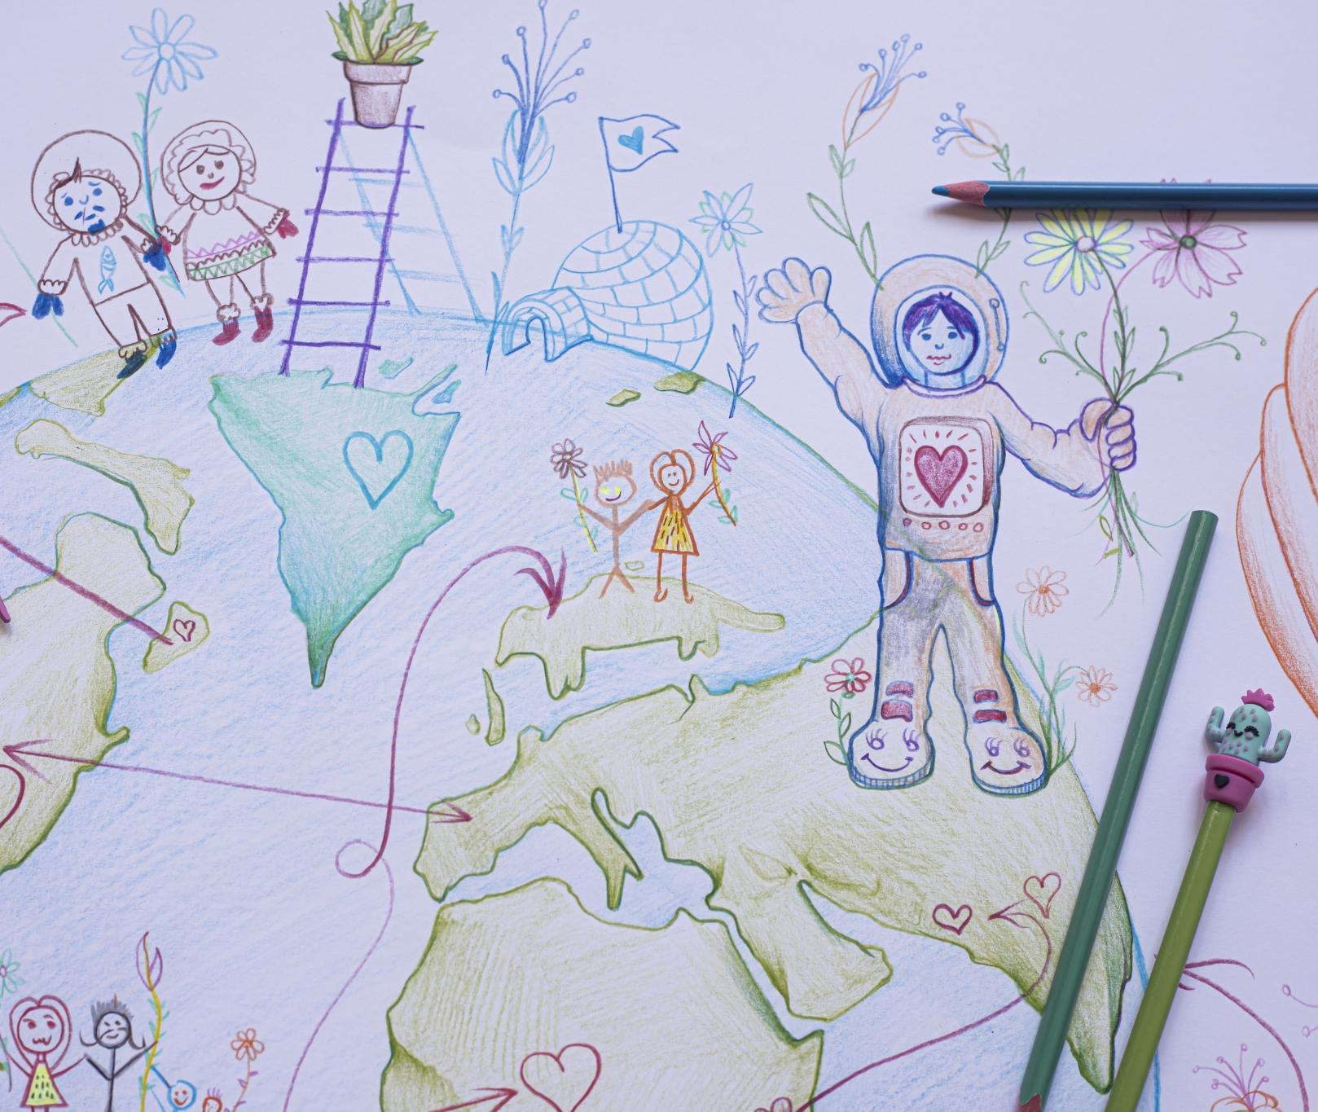
Herbie & Brindle’s Journey
Life Story Work Process
  Life Story Work helped Herbie and Brindle explore early memories and foster care experiences for emotional clarity.
Understanding Placement Reasons
  The siblings gained understanding of why they were placed in care following their parents’ accident.
Building a Sense of Belonging
  Recognizing love from birth, foster, and adoptive families fostered their sense of belonging and identity.
Notes:
Herbie and Brindle are fictional siblings who entered care after their parents were hospitalized due to a car accident. Through Life Story Work, they explored their early memories, foster experiences, and eventual adoption. The process helped them understand why they were placed in care, recognize the love from both birth and foster families, and build a sense of belonging with their adoptive parents. Visual storytelling, memory boxes, and guided conversations were used to support their emotional development and identity formation.

Slide 7
Resources
Notes:
Templates and Guides

Slide 8

Templates and Guides
Accessible Templates
  Social workers can download Word and PowerPoint templates to aid Life Story Work efficiently.
Curated Image Prompts
  Image prompt lists help professionals engage clients and stimulate storytelling effectively.
Online Resource Access
  QR codes link to online portals offering training materials, examples, and printable worksheets.
User-Friendly Design
  Tools are adaptable for various age groups and care settings to support diverse client needs.
Notes:
Social workers can access a variety of templates and guides to support Life Story Work. These include downloadable Word documents, PowerPoint presentations, and curated image prompt lists. QR codes embedded in the presentation link to online resources such as www.ailifestorywork.co.uk, where professionals can find training materials, example stories, and printable worksheets. These tools are designed to be user-friendly and adaptable to different age groups and care contexts.

Slide 9
Life Story Sections
Notes:
Who Am I?, My Early Days, My Birth Family, My Foster Family, My Adoption Story, My Life Now, My Feelings, My Memory Box, My Future

Slide 10
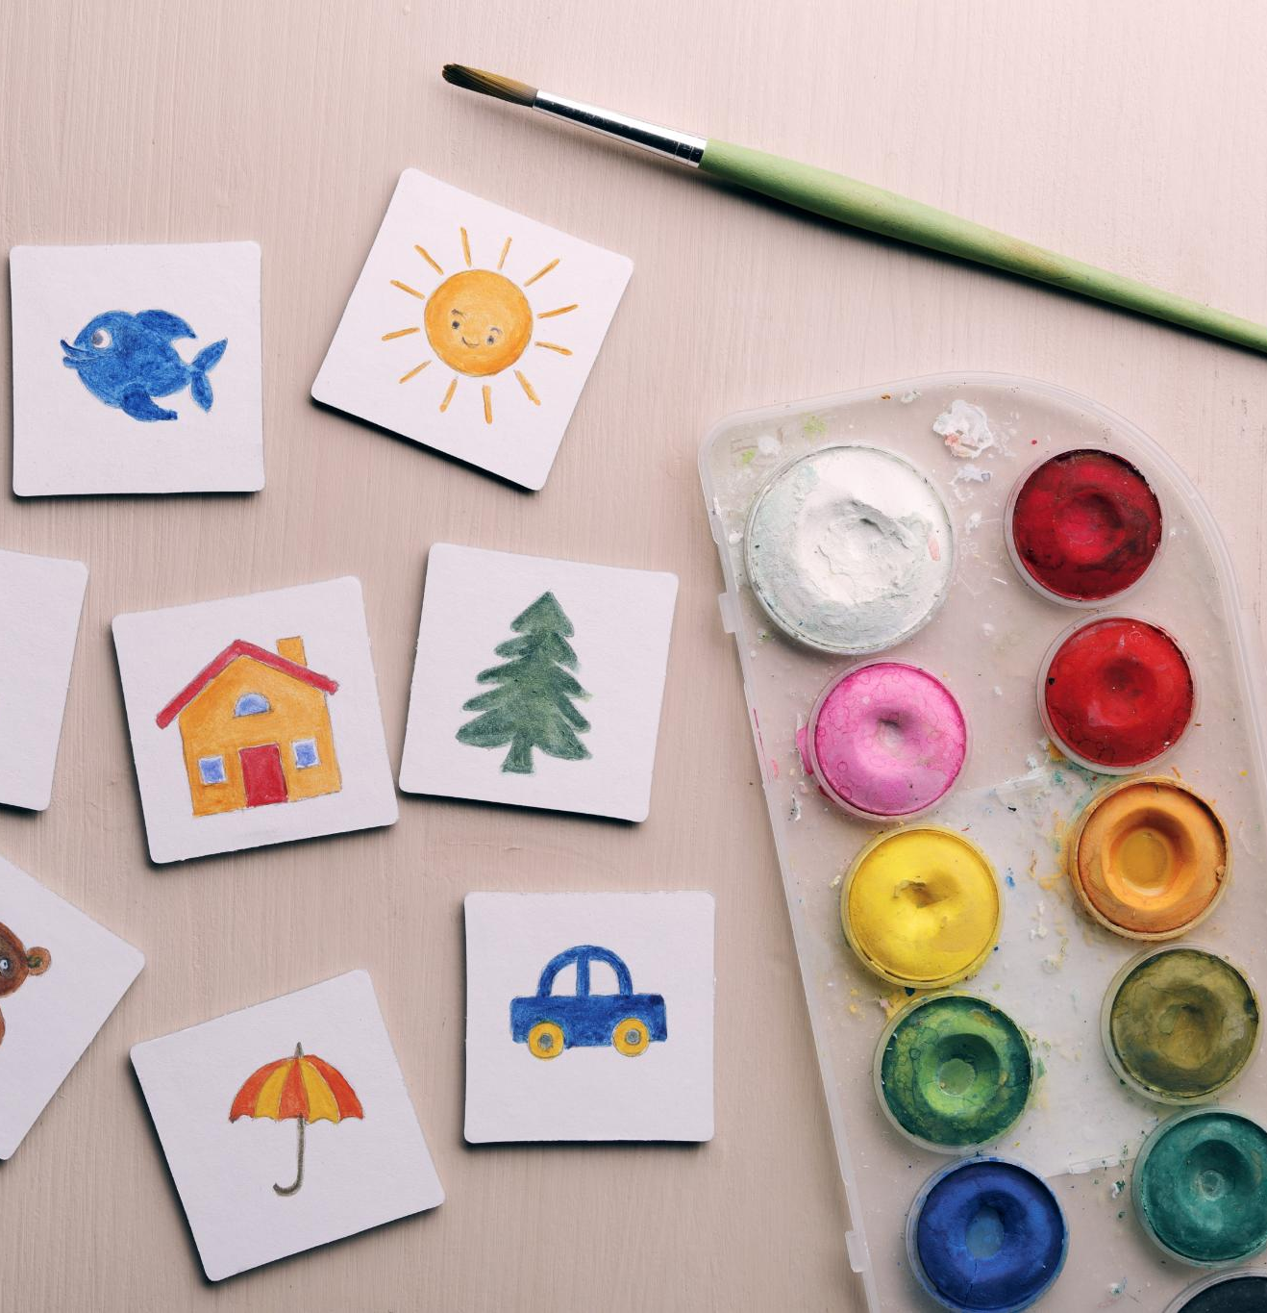
Who Am I?
Child's Identity Components
  Key identity aspects include name, birth date, favorite things, and personality traits that define uniqueness.
Visual Personalization Tools
  Drawings, photos, and name cards are effective visual prompts that help personalize the child's identity section.
Examples of Personal Interests
  Children's interests like dinosaurs, painting, and building blocks highlight individuality and shared joys.
Notes:
This section focuses on the child's identity, including their name, birth date, favourite things, and personality traits. It helps children affirm who they are and what makes them unique. Visual prompts such as drawings, photos, and name cards can be used to personalize this section. For Herbie and Brindle, this included their love for dinosaurs and painting, and their shared joy in playing with building blocks.

Slide 11
My Early Days
Early Life Reflections
Children consider memories of their early environment and caregivers to understand their beginnings and identity.
Milestone Memories
Important early milestones like first steps, birthdays, and family routines shape children’s personal history.
Memory Recall Techniques
Social workers use photos, timelines, and sensory prompts to help children recall and process early memories effectively.
Notes:
Children reflect on their early life experiences, including where they lived and who cared for them. This section may include milestones like first steps, birthdays, and family routines. For Herbie and Brindle, early memories included playing with bubbles in the garden and bedtime stories from their parents. Social workers can use photos, timelines, and sensory prompts to help children recall and process these memories.

Slide 12

My Birth Family
Age-Appropriate Information
  Providing gentle explanations about a child's birth family helps them understand their origins safely and clearly.
Sensitive Communication
  Social workers use careful, supportive language to address complex emotions related to family circumstances.
Understanding Family Circumstances
  Explaining situations like parental hospitalization helps children grasp reasons for their care placement sensitively.
Notes:
This section provides gentle, age-appropriate information about the child's birth family. It helps children understand their origins and the circumstances that led to their placement in care. For Herbie and Brindle, this included learning that their parents were hospitalized after an accident and wanted them to be safe. Social workers should approach this section with sensitivity, using supportive language and visuals to convey complex emotions.

Slide 13

My Foster Family
Experiencing Foster Care
  Children reflect on daily routines and loving relationships developed with their foster carers, highlighting emotional support.
Special Family Activities
  Fun activities like fishing trips, baking, and visits create lasting positive memories for children in foster care.
Memories Through Keepsakes
  Photos, drawings, and activity logs enrich children's foster care stories and foster positive recollections.
Notes:
Children explore their experiences with foster carers, including routines, special memories, and relationships. This section helps validate the care and support received during foster placement. Herbie and Brindle enjoyed fishing trips, baking cakes, and attending a fire station open day with their foster family. Including photos, activity logs, and drawings can enrich this section and foster positive recollections.

Slide 14
My Adoption Story
Adoption Journey Introduction
This story highlights how the child met their adoptive parents and key moments in the adoption process, emphasizing permanence.
Welcome-Home Celebration
The story includes a welcome-home event with balloons and cake, celebrating the new family bond and joy.
Use of Storytelling and Symbols
Social workers use storytelling, photos, and symbolic items to help children mark their adoption transition securely.
Notes:
This section explains how the child met their adoptive parents and key moments in the adoption journey. It celebrates the formation of a permanent family and helps children feel secure in their new identity. Herbie and Brindle's story included a welcome-home celebration with balloons and cake. Social workers can use storytelling, photos, and symbolic items to mark this transition.

Slide 15
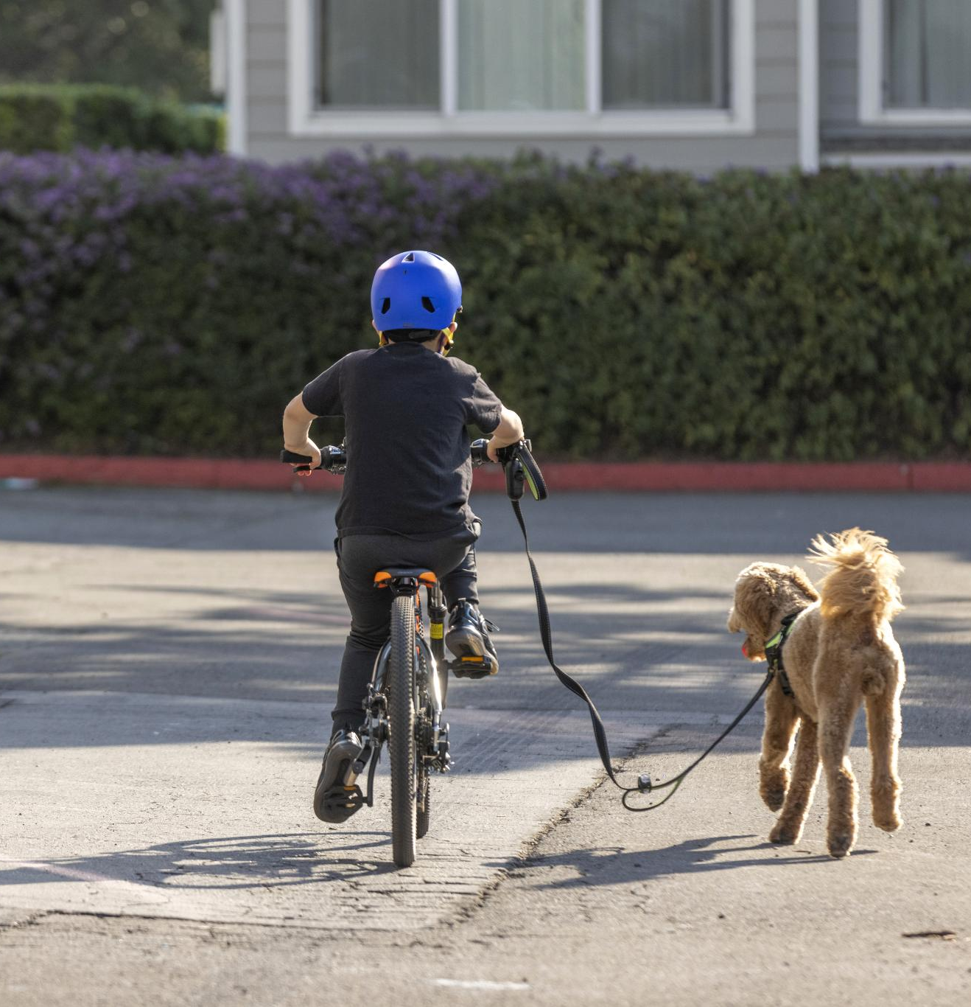
My Life Now
Current Routines and Hobbies
  Children engage in daily activities like riding bikes and playing football, fostering joy and healthy habits.
Relationships and Companionship
  Spending time with pets and friends nurtures emotional well-being and social skills in children.
School Experiences and Personalization
  Including school photos, drawings, and activity snapshots helps personalize children's stories and celebrate their achievements.
Notes:
Children describe their current routines, hobbies, relationships, and school experiences. This section affirms their present life and encourages pride in their achievements. Herbie and Brindle enjoy riding bikes, playing football, and spending time with their pet dog Max. Social workers can include school photos, drawings, and activity snapshots to personalize this section.

Slide 16
My Feelings
Expressing Emotions
Children use feeling faces and drawings to communicate their emotional experiences effectively.
Emotional Literacy Support
Guided conversations support emotional literacy and build resilience in children.
Tools for Facilitation
Social workers use tools like emotion cards, glitter jars, and storytelling to aid emotional expression.
Notes:
This section helps children express emotions and reflections using feeling faces, drawings, and guided conversations. It supports emotional literacy and resilience. Herbie and Brindle used smiley and sad face drawings to share how they felt about different experiences. Social workers can use emotion cards, glitter jars, and storytelling to facilitate this process.

Slide 17
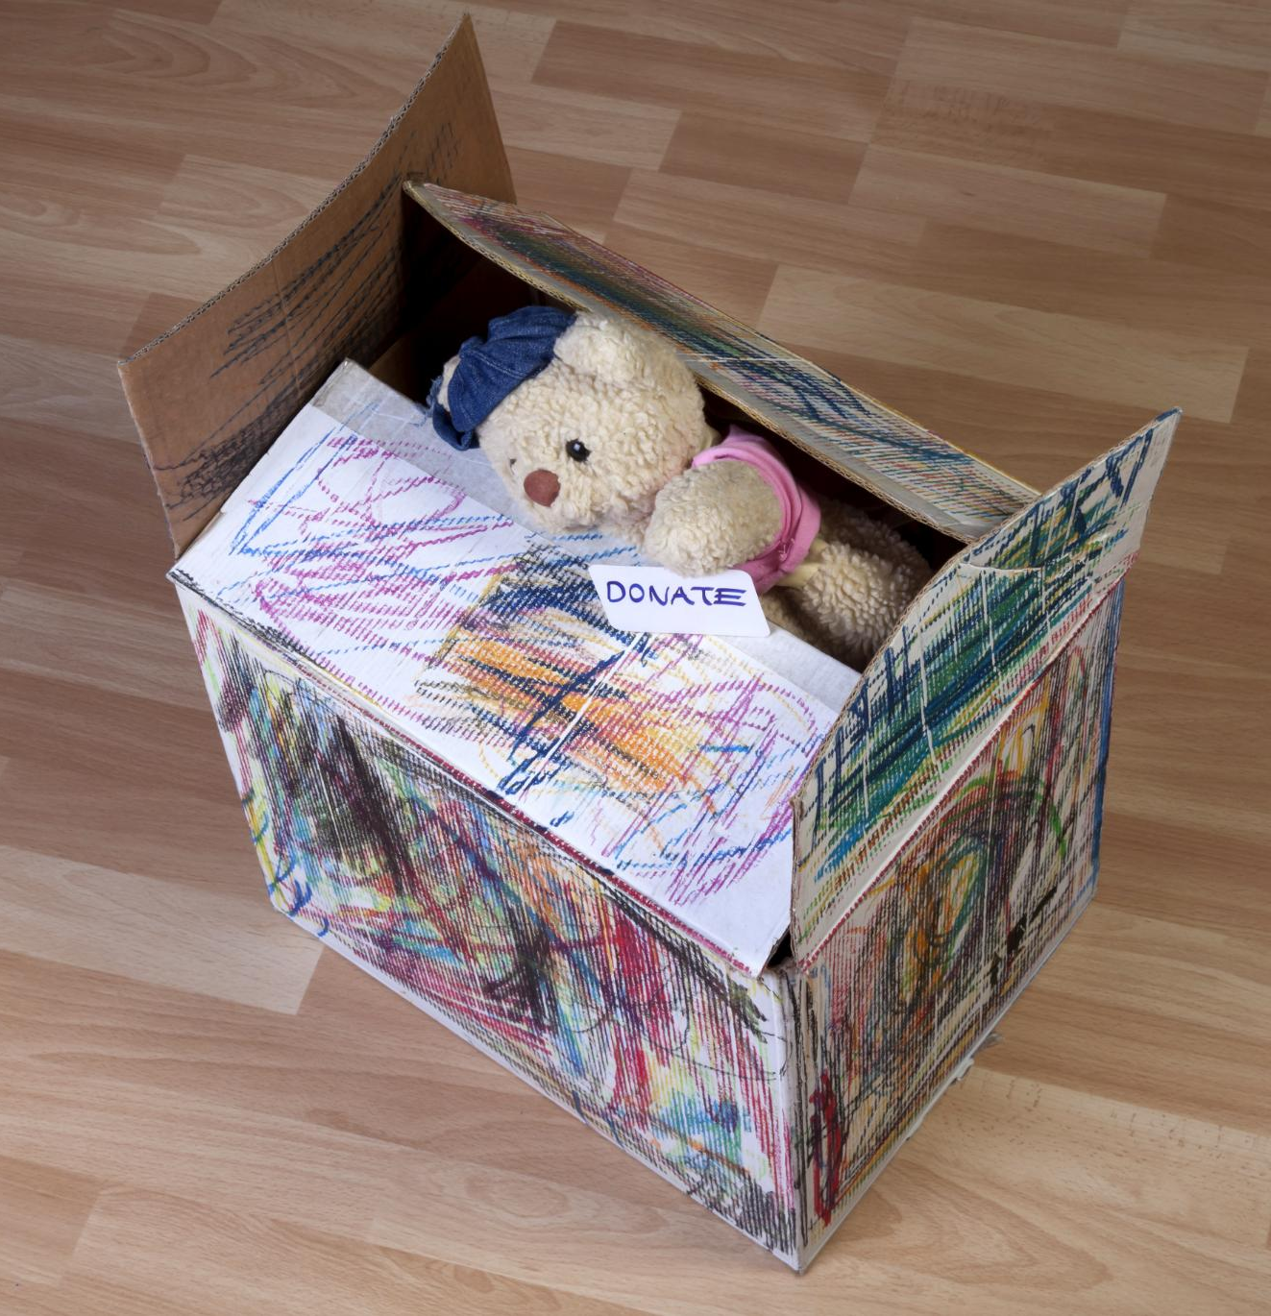
My Memory Box
Keepsakes for Identity
  Children collect keepsakes like photos and letters to preserve memories and support identity development.
Personalized Memory Boxes
  Herbie and Brindle’s memory box contains personal items such as baby shoes, birthday cards, and a teddy bear.
Role of Social Workers
  Social workers assist children in curating and labeling items, documenting contents with photos.
Notes:
Children list keepsakes, photos, letters, and certificates from each life stage. This section preserves meaningful items and supports identity formation. Herbie and Brindle's memory box included baby shoes, birthday cards, and a teddy bear from their birth family. Social workers can help children curate and label items, and use photos to document the box contents.

Slide 18

My Future
Children's Aspirations
  Children express their hopes and dreams, such as becoming firefighters or artists, fostering optimism.
Support from Social Workers
  Social workers support children’s future planning using drawings, vision boards, and encouraging letters.
Notes:
Children share hopes, dreams, and messages from adoptive parents and social workers. This section fosters optimism and goal-setting. Herbie dreams of being a firefighter, and Brindle wants to be an artist. Social workers can use drawings, vision boards, and letters to support future planning and encouragement.

Slide 19
Appendix
Notes:
Example Image Prompts

Slide 20

Example Image Prompts
Comprehensive Image Prompts
  The appendix offers 70 detailed image prompts organized by section to aid visual storytelling.
Supporting Visual Storytelling
  Prompts help generate or select images that align with distinct parts of a life story narrative.
Use by Social Workers
  Social workers use these prompts to guide image choice and improve engagement with clients.
Notes:
This appendix includes a full list of 70 example image prompts grouped by section. These prompts are designed to support visual storytelling and can be used to generate or select images that align with each part of the life story. Prompts include scenes such as 'Herbie and Brindle fishing with foster dad', 'drawing emotions with crayons', and 'packing a memory box'. Social workers can use these prompts to guide image selection and enhance engagement.

