Slide 1
Brindle & Herbie’s Big Adventure
Join the exciting journey full of surprises and discoveries
Notes:
---

Slide 2
Life Story Sections
Notes:
Who Am I?, My Early Days, My Birth Family, My Foster Family, My Adoption Story, My Life Now, My Feelings, My Memory Box, My Future

Slide 3
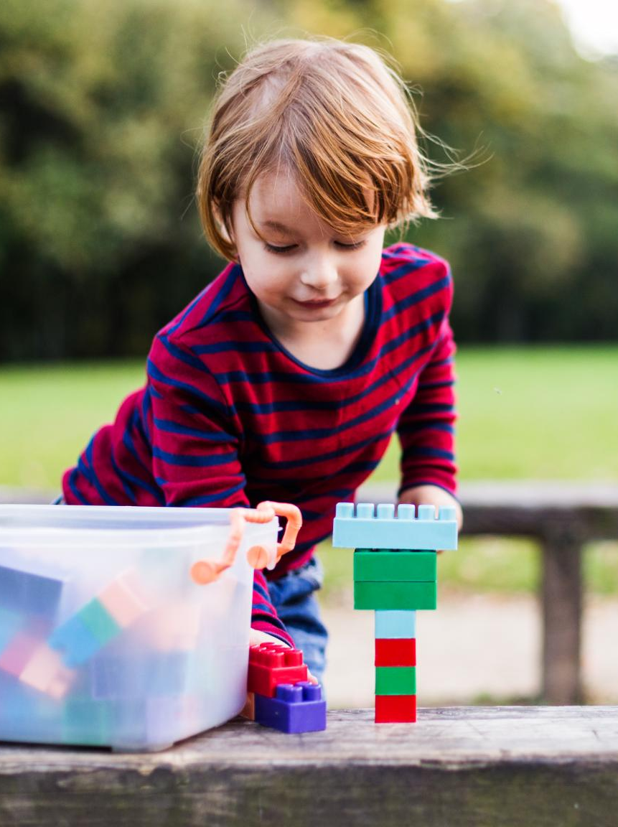
Who Am I?
Sibling Bond and Play
  Herbie and Brindle share a joyful bond through playing with cars and building blocks together.
Individual Interests
  Herbie enjoys dinosaurs while Brindle expresses creativity through painting.
Home and Activities
  The brothers were born in Dorset and enjoy sunny park walks together.
Notes:
Herbie and Brindle, you are two happy brothers who love playing with cars and building blocks. Herbie loves dinosaurs, and Brindle loves painting. You were born in Dorset and enjoy sunny walks in the park.

Slide 4
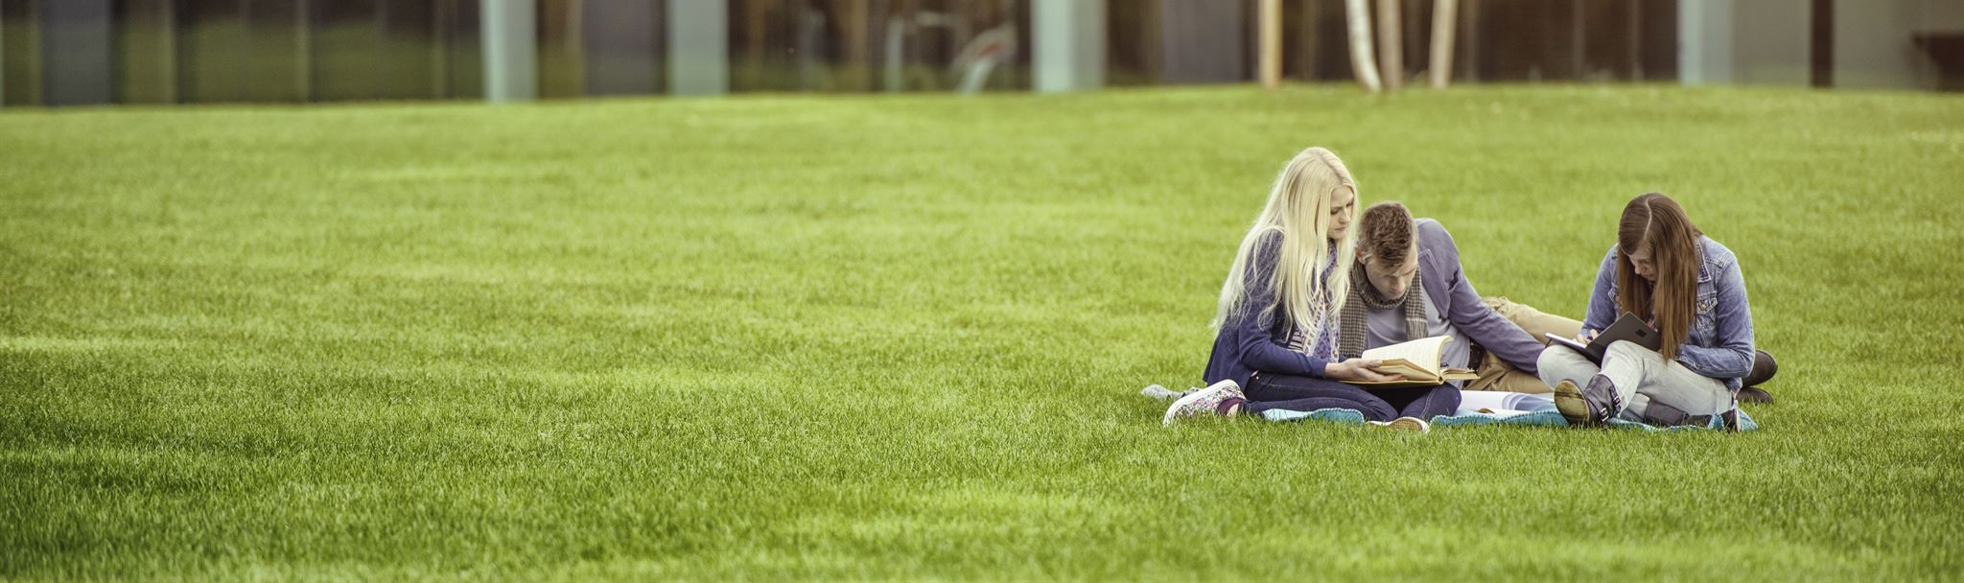
My Early Days
Early Home Environment
  The first home featured a spacious garden where playful activities like blowing bubbles took place.
Family Bedtime Rituals
  Parents enjoyed reading bedtime stories every night, fostering a loving and nurturing atmosphere.
Notes:
You were born in Dorchester. Your first home had a big garden where you played with bubbles. Mum and Dad loved reading bedtime stories to you every night.

Slide 5

My Birth Family
Reason for Care
  Herbie and Brindle were taken into care due to their parents' hospitalization after a car accident.
Parents' Love
  Their parents loved them deeply and wanted them protected until recovery.
Notes:
Herbie and Brindle, you had to be taken into care because your mum and dad were in hospital after a car accident. They loved you very much and wanted you to be safe until they got better.

Slide 6
My Foster Family
Nurturing Care
Foster parents cared deeply, treating you like their own child with love and support.
Learning to Bake
You learned how to bake cakes together, creating joyful memories in the kitchen.
Weekend Fishing Trips
Foster family took you fishing on weekends, enjoying peaceful outdoor moments.
Notes:
You stayed with foster mum and dad who cared for you like their own. They taught you how to bake cakes and took you fishing on weekends.

Slide 7

My Adoption Story
Meeting Your Forever Family
  The moment you met your forever family marked the beginning of a loving new chapter in your life together.
Welcoming Celebration
  Your family celebrated your arrival with balloons and a big cake, symbolizing joy and new beginnings.
Notes:
One day, you met your forever family. They were so excited to welcome you home. You had balloons and a big cake to celebrate your new start together.

Slide 8
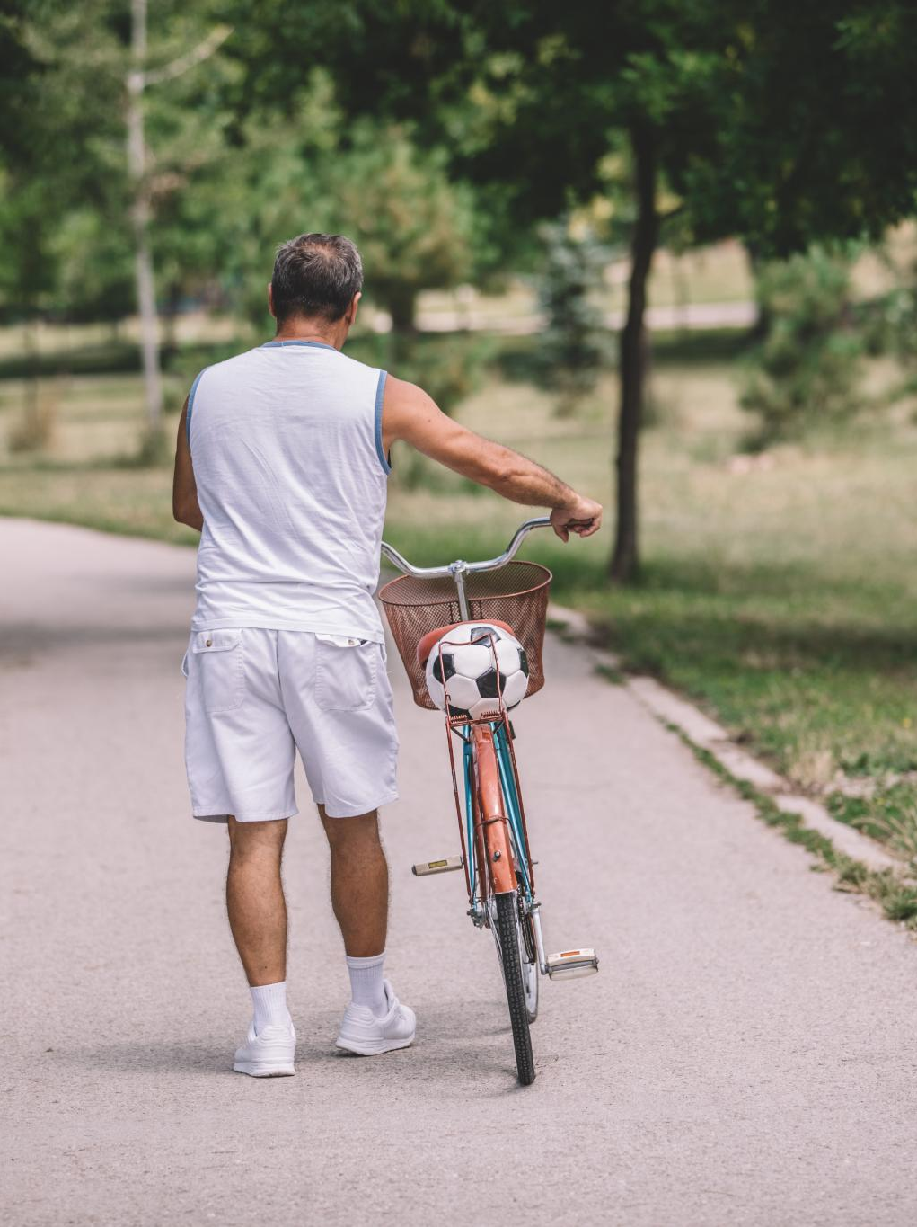
My Life Now
Outdoor Activities
  Enjoy riding bikes and playing football in the park with friends for fun and health.
School Life
  Going to school with friends builds social connections and learning experiences.
Pet Companionship
  Having a pet dog who loves cuddles brings joy and companionship to daily life.
Notes:
You love riding bikes, playing football in the park, and going to school with your friends. You have a pet dog called Max who loves cuddles.

Slide 9
My Feelings
Feeling Happy
Feeling happy often happens during play and joyful interactions with others.
Feeling Sad
Feeling sad can occur when missing loved ones or during quiet reflective moments.
Accepting Emotions
It is normal and okay to experience a wide range of emotions every day.
Notes:
Sometimes you feel happy when you play, and sometimes you feel sad when you miss people. It’s okay to have lots of feelings.

Slide 10
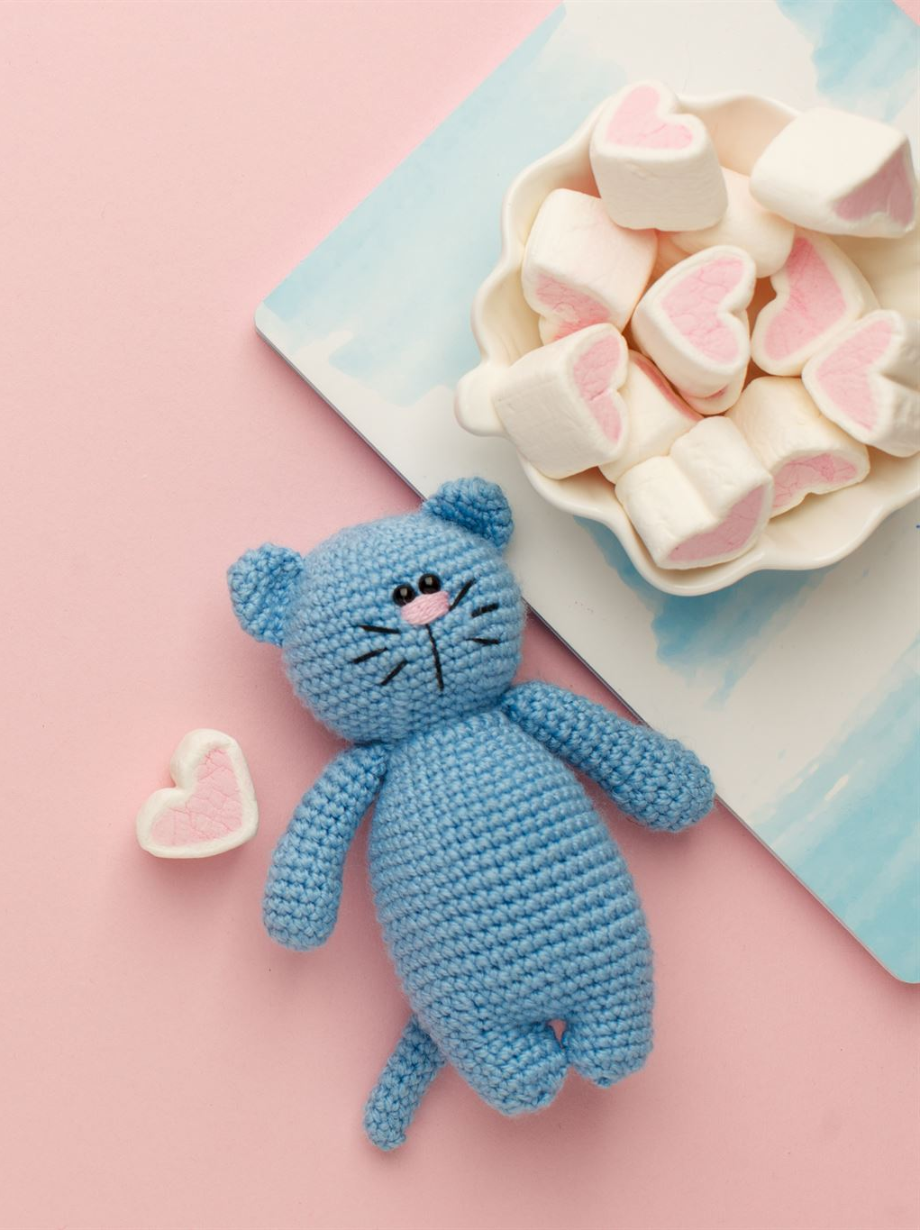
My Memory Box
First Shoes
  The memory box holds your first shoes, symbolizing early childhood memories and milestones.
Birthday Cards
  Birthday cards in the box capture special celebrations and heartfelt wishes from loved ones.
Teddy Bear Keepsake
  A teddy bear from your birth family represents comfort and cherished family bonds.
Notes:
Your memory box has your first shoes, birthday cards, and a teddy bear from your birth family.

Slide 11
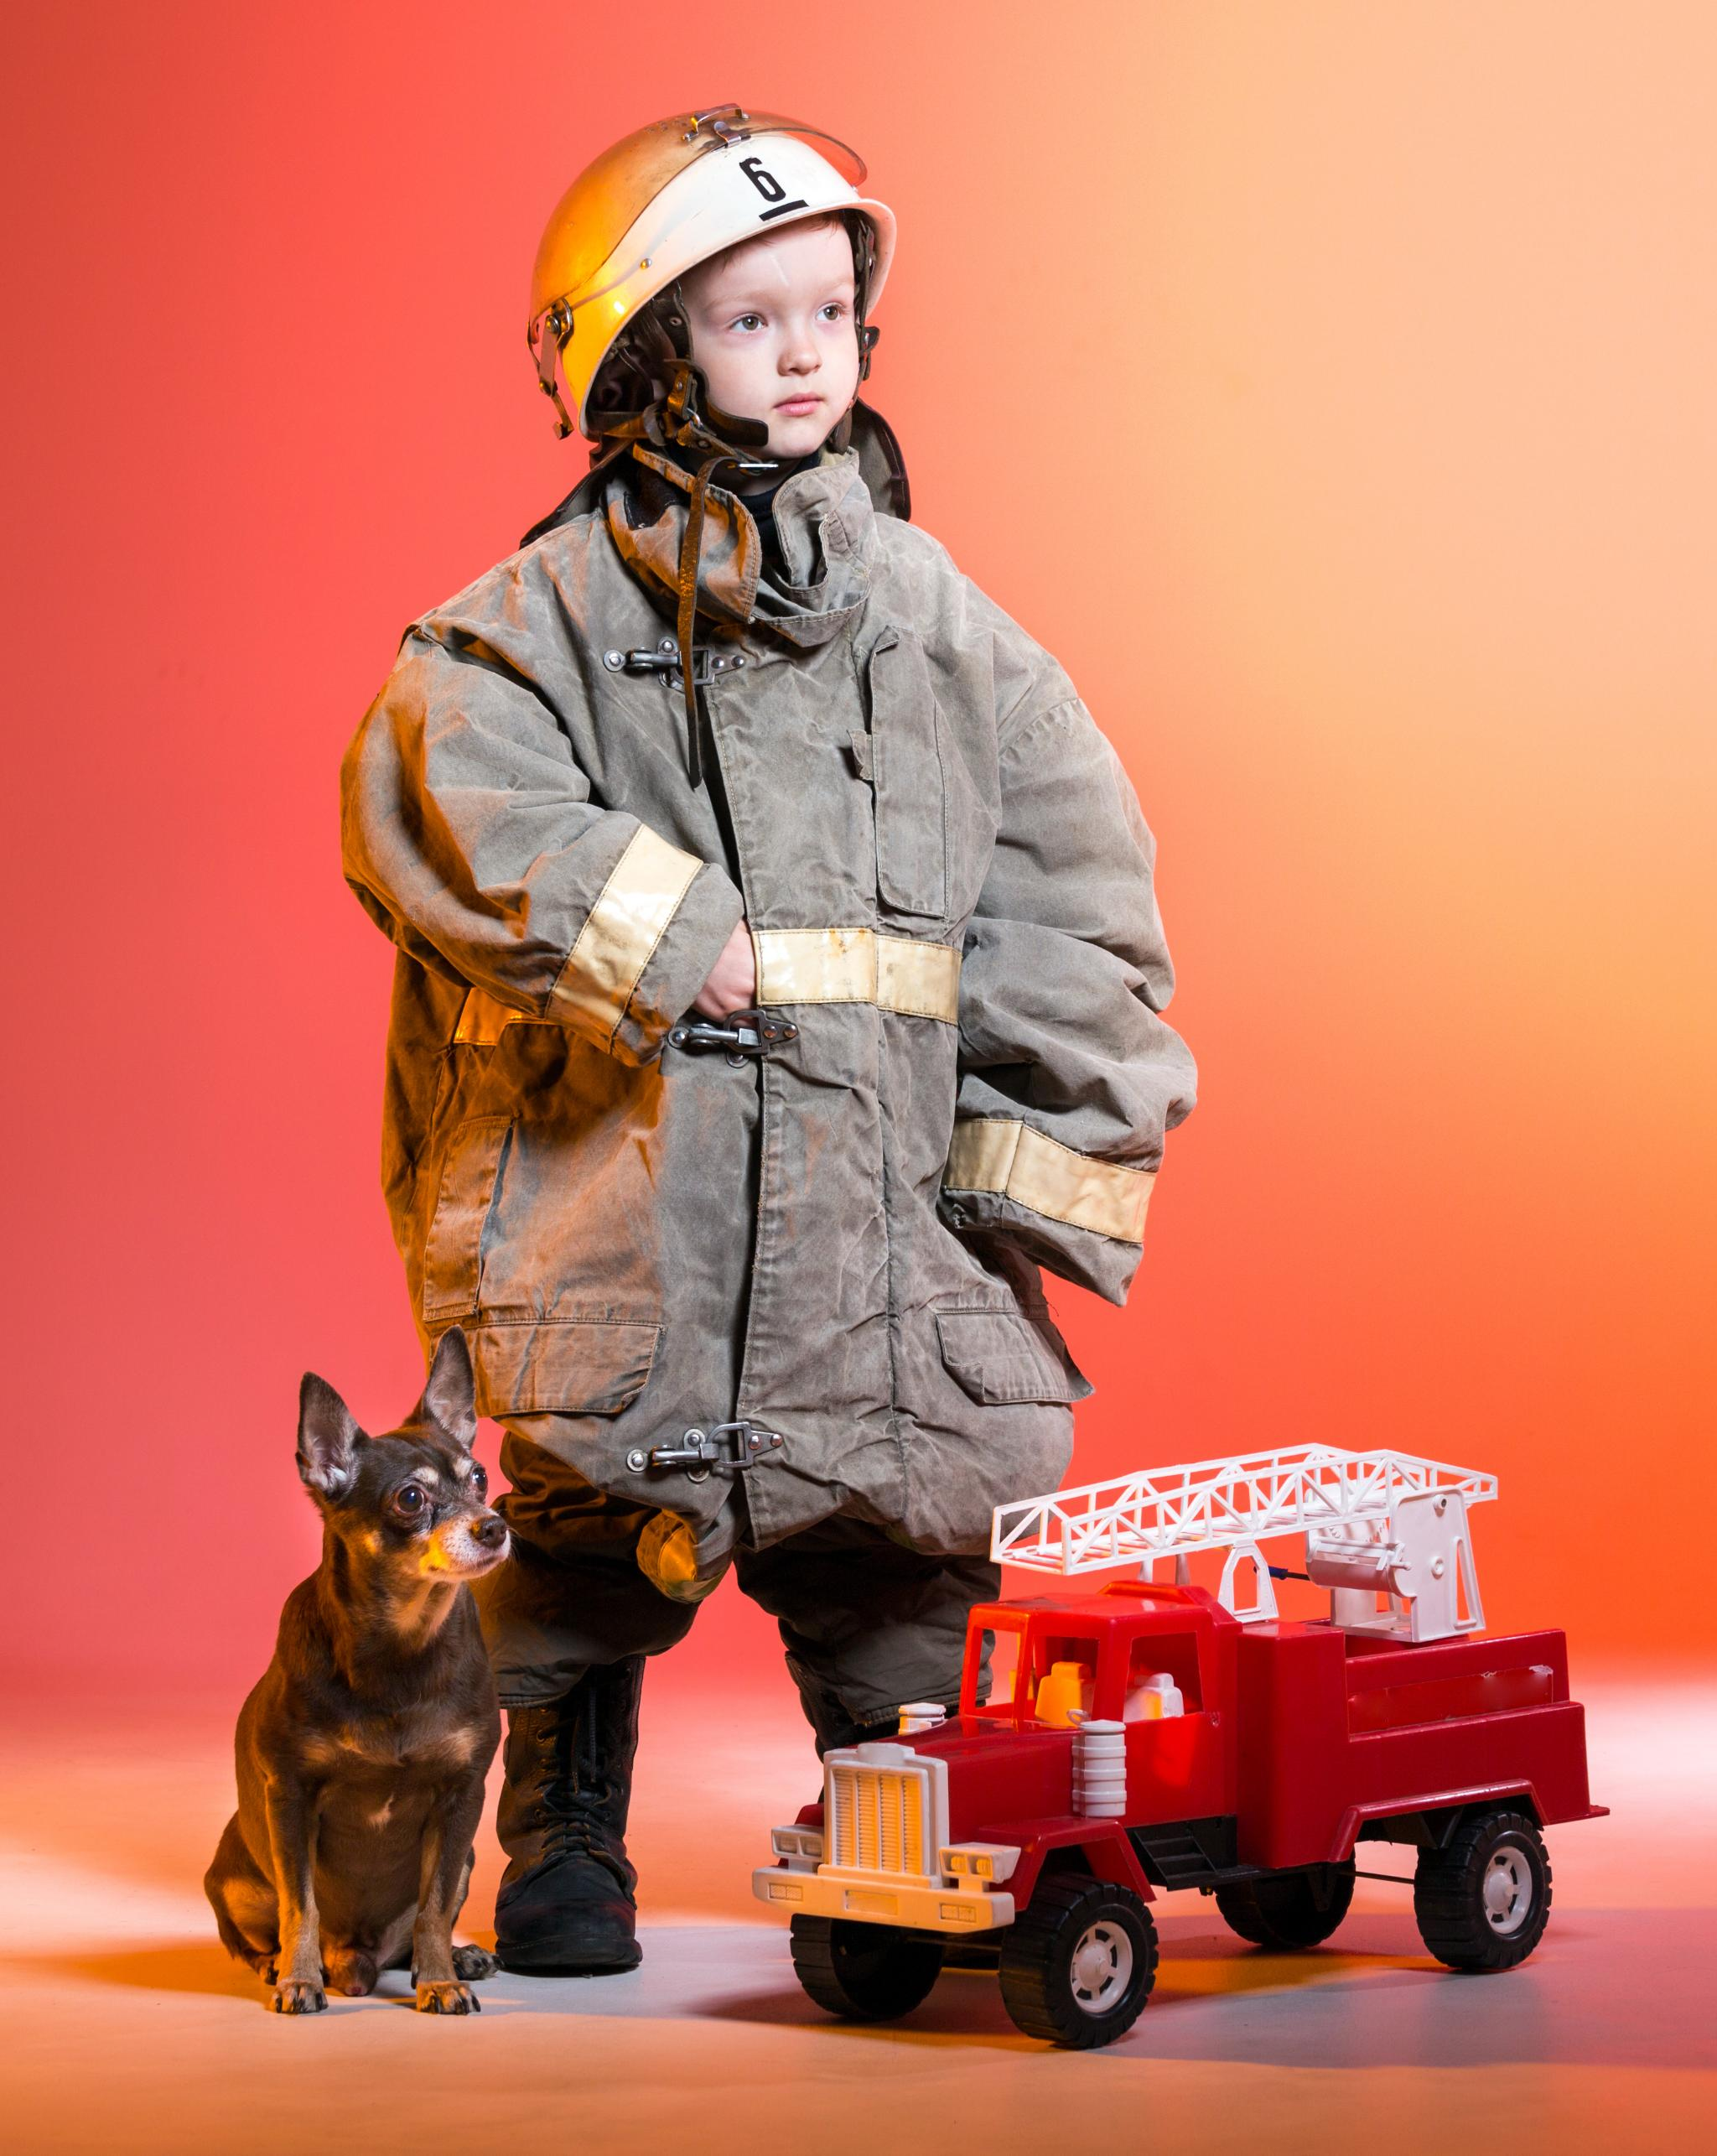
My Future
Aspiration to be Firefighter
  You dream of becoming a firefighter, a hero who helps and protects the community.
Aspiration to be Artist
  You aspire to express creativity and emotions through art as an artist.
Family Support
  Your family provides unwavering support, encouraging you in all your dreams and endeavors.
Notes:
You dream of being a firefighter and an artist. Your family will always support you in everything you do.

Slide 12
Appendix
Notes:
Full Example Image Index

Slide 13
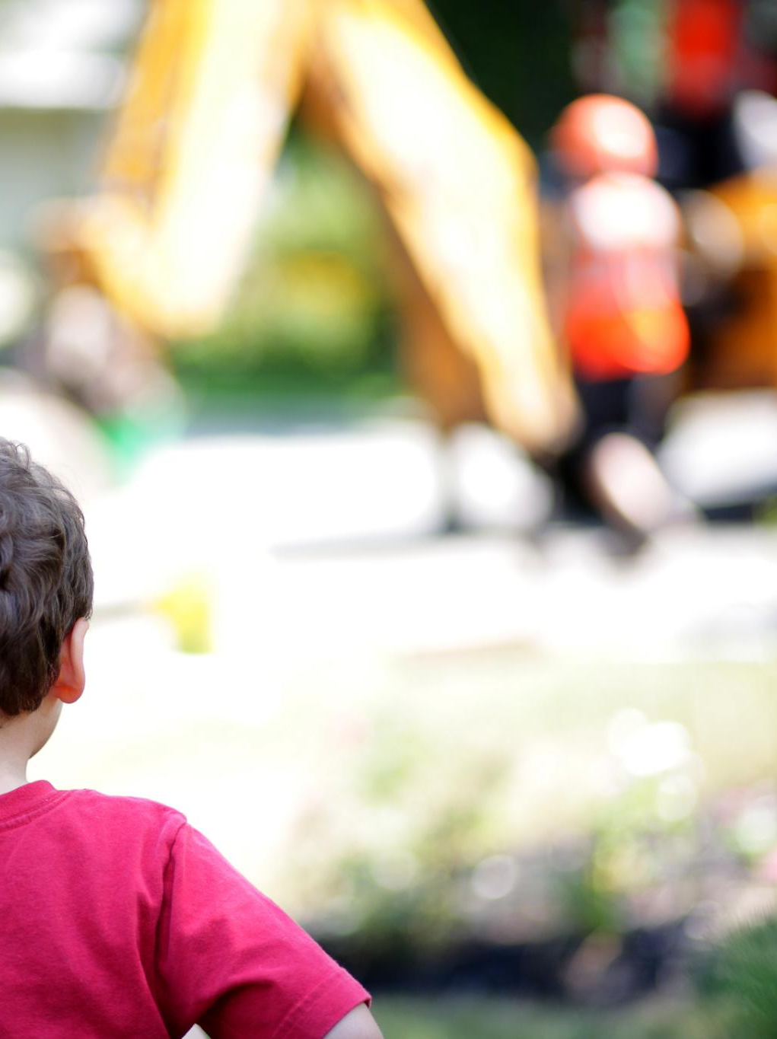
Full Example Image Index
Curated Image Prompts
  A collection of 70 landscape-oriented image prompts support the life story visually and thematically.
Warm and Supportive Themes
  Images reflect warmth, support, and family-focused themes to foster emotional connection with children.
Authentic Childhood Moments
  Prompts include authentic scenes like playing with dinosaurs, fire station visits, and birthday parties.
Notes:
This appendix contains a curated list of 70 example image prompts designed to visually support each section of the life story. These prompts are landscape-oriented and reflect warm, supportive, and family-focused themes consistent with the branding of www.ailifestorywork.co.uk. They include scenes such as Herbie and Brindle playing with dinosaurs, fishing with foster dad, attending a fire station open day, and celebrating a birthday party at the village hall. Each prompt is crafted to evoke emotional resonance and authenticity, helping children connect with their story through visual representation.

