Slide 1

Life Story Work Master Training
Developing expert skills in personal narrative techniques
Notes:
---

Slide 2
Introduction to Life Story Work
Notes:
Purpose and Benefits of Life Story Work

Slide 3

Purpose and Benefits of Life Story Work
Therapeutic Development Process
  Life Story Work helps children understand their past and envision a hopeful future through reflective storytelling.
Support for Children in Care
  This process supports identity formation, emotional regulation, and placement stability for children in care.
Trauma-Informed and Creative Tools
  Use of trauma-informed practice with creative tools like visual storytelling and memory boxes enhances communication.
Empowering the Child
  Social workers guide children to feel safe, heard, and empowered throughout the Life Story Work process.
Notes:
Life Story Work is a therapeutic and developmental process that helps children understand their past, embrace their present, and dream about their future. It is especially important for children in care, as it supports identity formation, emotional regulation, and placement stability. This training introduces the principles of Life Story Work, including age-appropriate communication, trauma-informed practice, and the use of creative tools such as timelines, memory boxes, and visual storytelling. Social workers are guided to begin with the child's present identity, gently explore the past, and build toward future hopes, ensuring the child feels safe, heard, and empowered throughout the process.

Slide 4
Life Story Work for Ages 5–6
Notes:
Key Sections and Visual Tools, Worker Script and Engagement Strategies

Slide 5
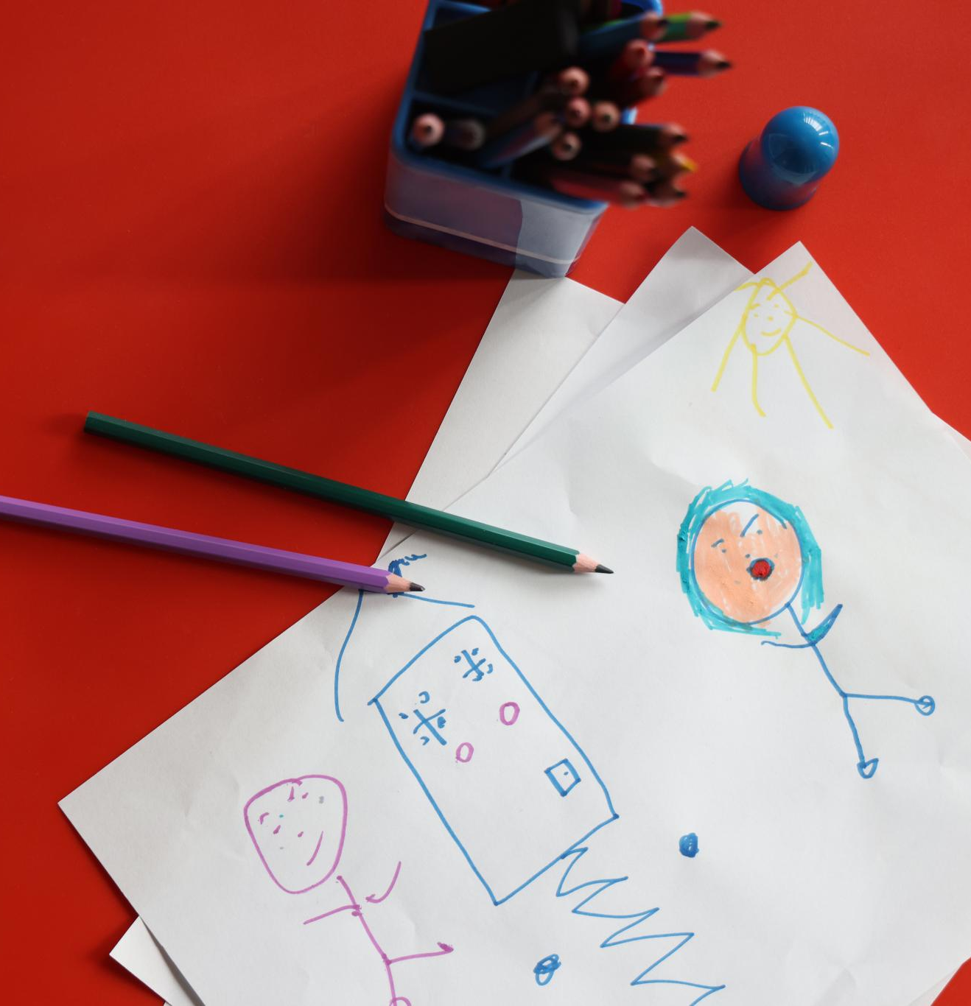
Key Sections and Visual Tools
Concise Visual Sections
  Life Story Work for young children uses short, concrete sections with simple language to promote understanding.
Use of Visual Aids
  Photos, stickers, drawings, and feelings faces are used to engage children and help express emotions clearly.
Supportive Tools for Social Workers
  Social workers use first–then boards and co-create pages with children to build safety and identity gently.
Notes:
For children aged 5–6, Life Story Work should be highly visual, concrete, and short. Key sections include 'Who I Am Right Now', 'My Everyday Life', 'People Who Keep Me Safe', 'My Story—Why I Came Into Care', 'My Feelings & Coping', 'My Memory Box', and 'My Hopes'. Each section uses simple language and visual aids such as photos, stickers, and drawings. Social workers are encouraged to use first–then boards, feelings faces, and co-create pages with the child. The goal is to build safety and identity while gently introducing the reasons for care in a non-blaming, safety-led manner.

Slide 6

Worker Script and Engagement Strategies
Clear Communication
  Use short, simple sentences and visual prompts to effectively engage young children aged 5–6.
Emotional Validation
  Validate children's feelings with comforting phrases to build trust and emotional literacy.
Calming Activities
  Use calming tools like drawing or cuddling toys to help children self-regulate emotions during sessions.
Session Closure
  End sessions with calming games or stories to create a safe and positive environment for children.
Notes:
Social workers should use short, clear sentences and visual prompts to engage children aged 5–6. Suggested phrases include: 'Grown-ups decided you needed to stay somewhere safe while Mum/Dad got help.' Validate feelings with statements like 'It’s okay to feel sad or wobbly. I’m here with you.' Encourage the child to identify safe adults and use calming activities such as drawing or cuddling a toy. The worker script emphasizes co-regulation, emotional literacy, and the importance of ending sessions with a calming game or story.

Slide 7
Life Story Work for Ages 7–8
Notes:
Key Sections and Visual Tools, Worker Script and Engagement Strategies

Slide 8
Key Sections and Visual Tools
Key Sections for Children
Sections like 'About Me', 'Important People', and 'My Story' help children reflect on their experiences and identity.
Visual Tools for Expression
Ribbon timelines, coping cards, and cultural maps assist children in understanding their journey and expressing themselves.
Supportive Social Work
Social workers encourage caption writing and safe exploration of children's questions about care and feelings.
Notes:
Children aged 7–8 are beginning to develop logical thinking and can engage with simple timelines and people maps. Key sections include 'About Me (Now)', 'Important People & Network', 'My Story—What Happened', 'Timeline', 'My Feelings & Coping', 'School & Achievements', 'Identity & Culture', 'Questions I Have', and 'Future Hopes'. Visual tools such as ribbon timelines, coping cards, and cultural maps help children understand their journey and express their identity. Social workers should encourage children to write or dictate captions and explore their questions about care in a safe and supportive way.

Slide 9

Worker Script and Engagement Strategies
Child-Friendly Communication
  Use simple phrases and tools like timelines and maps to explain events clearly to children aged 7–8.
Coping Strategies
  Co-create coping techniques such as breathing exercises, drawing, and talking to support emotional regulation.
Celebration and Planning
  Celebrate children's achievements and cultural identity while planning future goals collaboratively.
Balanced Session Activities
  Alternate between creative activities and talk-based sessions to keep children engaged and comfortable.
Notes:
For ages 7–8, the worker script includes phrases like: 'There were adult problems that made home unsafe. Adults made a plan to keep you safe.' Social workers should use timelines and maps to explain events and invite questions from the child. Coping strategies such as breathing exercises, drawing, and talking should be co-created with the child. The script encourages celebrating achievements and cultural identity, and planning future goals together. Sessions should alternate between creative and talk-based activities to maintain engagement.

Slide 10
Life Story Work for Ages 9–10
Notes:
Key Sections and Visual Tools, Worker Script and Engagement Strategies

Slide 11
Key Sections and Visual Tools
Key Sections for Engagement
Key sections address children's strengths, relationships, safety, identity, rights, and future aspirations comprehensively.
Visual Tools for Deeper Understanding
Visual aids such as decision maps, goal ladders, and cultural symbols enhance children's comprehension and participation.
Supporting Children's Voice
Social workers should clearly explain roles, validate children's voices, and promote advocacy and rights awareness.
Notes:
Children aged 9–10 are capable of understanding multiple causes and making sense of roles and decisions. Key sections include 'Me, My Strengths & Values', 'People, Roles & Decisions', 'My Life Story—The Bigger Picture', 'Detailed Timeline', 'Contact & Relationships', 'Health & Safety Plan', 'Identity & Belonging', 'Tough Topics', 'School & Achievements', 'My Rights & My Voice', and 'Future Me'. Visual tools such as decision maps, goal ladders, and cultural symbols support deeper engagement. Social workers should explain roles clearly, validate the child’s voice, and support advocacy and rights awareness.

Slide 12

Worker Script and Engagement Strategies
Clear Communication
  Social workers must explain roles, decisions, and rights clearly during engagement with children aged 9–10.
Addressing Difficult Topics
  Use correct terminology like 'irreversible' and 'universal' to sensitively discuss bereavement and other tough issues.
Structured Support Sessions
  Sessions should be paced, structured, and include reflection and planning opportunities for realistic goal setting.
Notes:
The worker script for ages 9–10 includes: 'There were different reasons home wasn’t safe enough then. Adults made a plan to keep you safe.' Social workers should explain roles and decisions clearly, capture the child’s views, and discuss rights and advocacy. Tough topics such as bereavement should be addressed using correct terms like 'irreversible' and 'universal'. The script encourages setting realistic goals with support steps and using visual tools to reinforce understanding. Sessions should be structured, paced, and include opportunities for reflection and planning.

Slide 13
Closing Summary
Notes:
Key Takeaways and Next Steps

Slide 14

Key Takeaways and Next Steps
Importance of Life Story Work
  Life Story Work supports children in care by building identity, emotional literacy, and stability.
Tailored Social Work Approach
  Social workers should customize methods based on developmental stages using visual and creative tools.
Utilizing Training Resources
  The training deck offers templates, scripts, and visual guidance for practitioners working with children aged 5-10.
Child Voice and Carer Involvement
  Practitioners should involve carers and ensure the child’s voice remains central throughout the process.
Notes:
Life Story Work is a vital tool for supporting children in care. It helps build identity, emotional literacy, and stability. Social workers should tailor their approach to the child’s developmental stage, use visual and creative tools, and maintain a trauma-informed, child-centered practice. The master training deck provides structured templates, worker scripts, and visual guidance for ages 5–10. Practitioners are encouraged to use these resources flexibly, involve carers, and ensure the child’s voice is central throughout the process.

