Slide 1
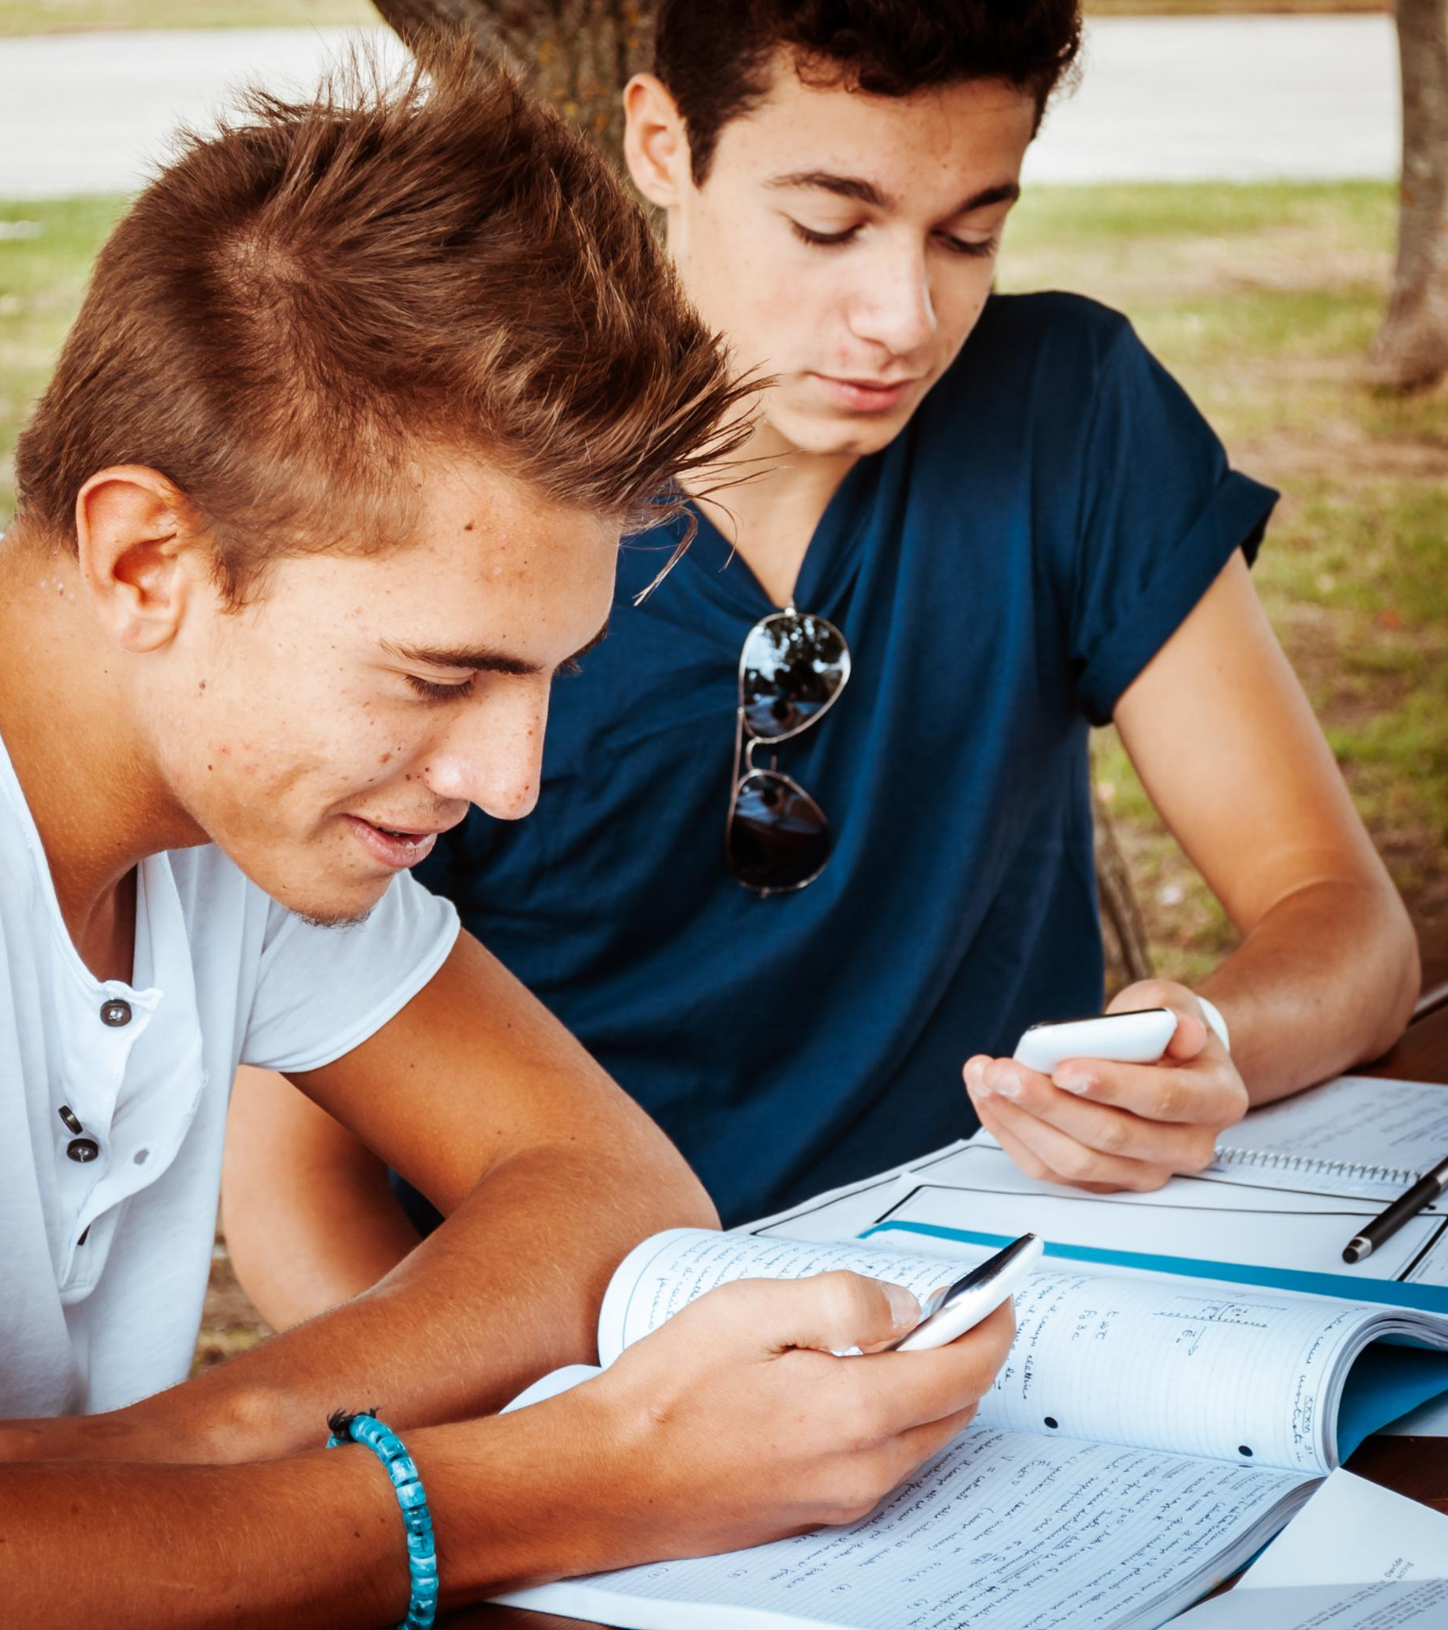
Life Story Work Template for Ages 11–15
A guide to meaningful personal reflection and growth
Notes:
AI-generated content may be incorrect. ---

Slide 2
Life Story Work Template
Notes:
--- This slide references information from the following file: https://www.stanfordchildrens.org/en/topic/default?id=cognitive-development-in-adolescence-90-P01594,https://www.scholastic.com/parents/family-life/creativity-and-critical-thinking/development-milestones/cognitive-development-11-13-year-olds.html Introduction & Purpose, Timeline of Life Events, My Identity, Relationships, My Feelings & Thoughts, My Strengths & Achievements, My Future, Reflections & Closure

Slide 3

Introduction & Purpose
Purpose of Life Story Work
Life story work helps adolescents understand their past and supports emotional healing and resilience.
Target Age Group
Focused on adolescents aged 11-15, who develop abstract reasoning and identity formation skills.
Structured Empathetic Approach
The approach ensures a supportive and empathetic environment for adolescents to engage in self-reflection.
Notes:
--- This slide references information from the following file: https://www.stanfordchildrens.org/en/topic/default?id=cognitive-development-in-adolescence-90-P01594,https://www.scholastic.com/parents/family-life/creativity-and-critical-thinking/development-milestones/cognitive-development-11-13-year-olds.html This section introduces the purpose and scope of the life story work for adolescents aged 11–15. It includes fields for the child’s name, the date the work began, and the social worker’s name. The purpose of life story work is to help the child understand their past, support identity formation, and promote emotional healing and resilience. Adolescents in this age group are developing abstract reasoning and a deeper sense of identity, making it essential to provide a structured and empathetic approach to their life story. This section sets the tone for the rest of the work and ensures that the child understands the goals and benefits of engaging in this reflective process.

Slide 4

Timeline of Life Events
Visual Timeline Format
The timeline uses a scrapbook style to visually document significant life events and milestones clearly.
Key Life Stages
The timeline covers birth, early care, foster care, adoption, school years, and adolescence stages.
Emotional Reflections
Each event includes the child’s feelings and reflections to help process emotions and experiences.
Supportive Framework
This structured method supports discussing complex or traumatic events in a safe, organized way.
Notes:
--- This slide references information from the following file: https://www.stanfordchildrens.org/en/topic/default?id=cognitive-development-in-adolescence-90-P01594,https://www.scholastic.com/parents/family-life/creativity-and-critical-thinking/development-milestones/cognitive-development-11-13-year-olds.html This section uses a visual timeline or scrapbook format to document key life events. It encourages the child to reflect on different stages of their life, including birth and early care, foster care or adoption, school years, and adolescence. Each entry includes age, event, location, people involved, and the child’s feelings or reflections. This chronological approach helps the child make sense of their experiences and see how they have evolved over time. It also provides a framework for discussing complex or traumatic events in a structured and supportive way, allowing the child to process their emotions and build a coherent narrative of their life.

Slide 5

My Identity
Cultural and Spiritual Background
Identity includes cultural roots, religion or spirituality, which shape the child's worldview and values.
Language and Personal Values
Languages spoken and personal values contribute to unique identity and self-expression in adolescents.
Self-Reflection and Resilience
Encouraging self-reflection builds pride in identity and strengthens resilience during adolescent development.
Support for Social Workers
Understanding a child's identity helps social workers tailor therapeutic support effectively.
Notes:
--- This slide references information from the following file: https://www.stanfordchildrens.org/en/topic/default?id=cognitive-development-in-adolescence-90-P01594,https://www.scholastic.com/parents/family-life/creativity-and-critical-thinking/development-milestones/cognitive-development-11-13-year-olds.html This section focuses on the child’s identity, including cultural background, religion or spirituality, languages spoken, personal values, and what makes them unique. Adolescents are at a critical stage of identity formation, and this section helps them explore and articulate who they are. It encourages self-reflection and pride in their heritage and personal traits. By understanding and affirming their identity, children can develop a stronger sense of self and resilience. This section also provides social workers with insights into the child’s worldview and values, which can inform the therapeutic approach and support provided.

Slide 6

Relationships
Mapping Important Relationships
Tools like family trees and genograms map key people in a child’s life including birth and foster families, friends, and pets.
Emotional Validation and Connection
Recognizing relationships helps validate the child’s experiences and supports emotional expression.
Discussing Attachment and Loss
This section provides a platform to explore attachment, loss, and separation impacts common in child care contexts.
Notes:
--- This slide references information from the following file: https://www.stanfordchildrens.org/en/topic/default?id=cognitive-development-in-adolescence-90-P01594,https://www.scholastic.com/parents/family-life/creativity-and-critical-thinking/development-milestones/cognitive-development-11-13-year-olds.html This section explores the child’s relationships through tools like family trees or genograms. It identifies important people in the child’s life, including birth family, foster or adoptive family, friends, and pets. It may also include letters or messages from key individuals. Understanding relationships is crucial for adolescents, as they begin to form deeper connections and question their place within family and social structures. This section helps validate the child’s experiences and emotions related to these relationships. It also provides a platform for discussing attachment, loss, and the impact of separation, which are common themes in life story work for children in care.

Slide 7

My Feelings & Thoughts
Emotional Expression
This section encourages children to share feelings like happiness, sadness, anger, and personal wishes for understanding.
Safe Emotional Space
Provides a supportive and safe environment for adolescents to articulate their intense emotions and thoughts.
Emotional Regulation and Growth
Supports emotional regulation and self-awareness, essential for cognitive and psychological development during adolescence.
Notes:
--- This slide references information from the following file: https://www.stanfordchildrens.org/en/topic/default?id=cognitive-development-in-adolescence-90-P01594,https://www.scholastic.com/parents/family-life/creativity-and-critical-thinking/development-milestones/cognitive-development-11-13-year-olds.html This section encourages the child to express their feelings and thoughts. Prompts include what they wonder about, what makes them happy, sad, or angry, what they wish people understood about them, and questions they have about their past. Adolescents often experience intense emotions and may struggle to articulate them. This section provides a safe space for emotional expression and helps the social worker understand the child’s internal world. It also supports emotional regulation and self-awareness, which are key components of cognitive and psychological development during adolescence.

Slide 8

My Strengths & Achievements
Showcasing Talents and Hobbies
Highlighting the child’s talents and hobbies nurtures creativity and personal interests, boosting confidence and joy.
Celebrating Achievements
Recognizing school achievements and personal milestones promotes a sense of accomplishment and pride.
Building Resilience and Growth
Focusing on moments of resilience helps build self-esteem and encourages a positive growth mindset.
Notes:
--- This slide references information from the following file: https://www.stanfordchildrens.org/en/topic/default?id=cognitive-development-in-adolescence-90-P01594,https://www.scholastic.com/parents/family-life/creativity-and-critical-thinking/development-milestones/cognitive-development-11-13-year-olds.html This section highlights the child’s talents, hobbies, school achievements, personal milestones, and moments of resilience. Focusing on strengths helps build self-esteem and a positive self-image. It allows the child to see themselves as capable and valued, which is especially important for those who have experienced trauma or instability. This section also provides a counterbalance to the more challenging aspects of their life story, reinforcing their ability to overcome adversity and succeed. It encourages a growth mindset and helps the child recognize their potential.

Slide 9

My Future
Envisioning Future Goals
Encourages children to think about hopes, dreams, and long-term goals for personal growth and development.
Career and Life Aspirations
Supports adolescents in exploring career ideas and where they want to live, fostering optimism and planning.
Fostering Resilience and Motivation
Helps children develop a positive outlook and motivation by reflecting on values and aspirations.
Notes:
--- This slide references information from the following file: https://www.stanfordchildrens.org/en/topic/default?id=cognitive-development-in-adolescence-90-P01594,https://www.scholastic.com/parents/family-life/creativity-and-critical-thinking/development-milestones/cognitive-development-11-13-year-olds.html This section invites the child to think about their future, including hopes and dreams, career ideas, where they want to live, and what kind of person they want to be. Adolescents are beginning to consider long-term goals and possibilities, and this section supports that developmental process. It encourages optimism and planning, helping the child envision a positive future. It also provides insights into the child’s aspirations and values, which can guide support and interventions. This forward-looking perspective is essential for fostering resilience and motivation.

Slide 10

Reflections & Closure
Self-Reflection Importance
Encourages the child to contemplate personal growth and lessons learned for deeper self-awareness.
Emotional Closure
Closure provides emotional resolution and helps integrate past experiences into a clear identity.
Supportive Message
The social worker’s message offers affirmation, encouragement, and strengthens the therapeutic bond.
Notes:
--- This slide references information from the following file: https://www.stanfordchildrens.org/en/topic/default?id=cognitive-development-in-adolescence-90-P01594,https://www.scholastic.com/parents/family-life/creativity-and-critical-thinking/development-milestones/cognitive-development-11-13-year-olds.html This final section allows the child to reflect on what they’ve learned about themselves, what they want to remember, what they want to leave behind, and includes a final message from the social worker. Closure is an important part of life story work, providing a sense of completion and emotional resolution. It helps the child integrate their experiences and move forward with a clearer understanding of their identity and history. The social worker’s message can offer affirmation, support, and encouragement, reinforcing the therapeutic relationship and the child’s journey.

