Slide 1

Comprehensive Life Story Work Template for Ages 11–15
Structured approach to capturing adolescent life experiences
Notes:
---

Slide 2
Introduction and Purpose
Notes:
Welcome & Purpose

Slide 3

Welcome & Purpose
Introduction to Life Story Work
  Life story work helps adolescents explore their identity and understand past experiences meaningfully.
Recording Personal Information
  The workbook includes spaces for the child's name, start date, and social worker's name for clarity and ownership.
Purpose and Reflection Prompts
  Prompts encourage reflection on reasons for life story work, aiding understanding of its importance.
Safe and Supportive Journey
  Establishes a safe, supportive environment for collaborative exploration of personal history.
Notes:
This section introduces the purpose of life story work for adolescents aged 11–15. It provides a space for the child to record their name, the date the workbook was started, and the name of the social worker facilitating the process. The prompts encourage reflection on why life story work is being undertaken, helping the young person understand its importance in exploring their identity, processing past experiences, and planning for the future. This foundational section sets the tone for a safe, supportive, and collaborative journey through their personal history.

Slide 4
Exploring Identity and Emotions
Notes:
Creative Identity Mapping, Jenga of Emotions, Mindfulness & Resilience

Slide 5

Creative Identity Mapping
Exploring Identity Creatively
  Creative activities help youth visualize and express their unique identities beyond words.
Fostering Self-Awareness
  Artistic exercises build confidence and encourage reflection on personality and values.
Engaging Non-Verbal Communication
  Non-verbal methods support adolescents who find verbal expression challenging.
Notes:
This slide invites the young person to explore their identity through creative expression. Activities such as creating a collage or designing an avatar help them visualize and articulate what makes them unique. These exercises foster self-awareness and confidence, allowing the child to reflect on their personality, values, and interests in a non-verbal and engaging way. This approach is particularly effective for adolescents who may struggle to express themselves through traditional conversation.

Slide 6

Jenga of Emotions
Interactive Emotional Exploration
  The activity uses a playful Jenga game to help adolescents identify and understand their emotions more easily.
Prompts for Emotional Recall
  Prompts guide participants to recall specific emotional experiences tied to different feelings during the game.
Building Emotional Resilience
  This method supports emotional literacy and resilience by normalizing a wide range of emotions through tactile interaction.
Notes:
Using a playful and interactive method, this section encourages adolescents to explore their emotional landscape. Prompts guide them to identify emotions they frequently experience and recall specific instances tied to those feelings. The metaphor of a Jenga game adds a tactile and visual dimension, making emotional exploration more accessible and less intimidating. This activity supports emotional literacy and helps build resilience by normalizing a range of emotional experiences.

Slide 7

Mindfulness & Resilience
Mindfulness Techniques
  Mindfulness exercises help adolescents achieve calmness and improve emotional regulation through focused awareness.
Building Resilience
  Resilience strategies encourage recalling past challenges and developing self-efficacy to manage adversity effectively.
Trauma-Informed Practices
  Trauma-informed approaches support mental wellbeing by fostering healthy coping mechanisms and emotional safety.
Notes:
This section introduces mindfulness techniques and resilience-building strategies. Adolescents are prompted to reflect on what helps them feel calm and recall times they overcame challenges. These exercises promote emotional regulation and self-efficacy, equipping young people with tools to manage stress and adversity. Incorporating trauma-informed practices, this slide supports mental wellbeing and encourages the development of healthy coping mechanisms.

Slide 8
Personal History and Life Events
Notes:
Story Fragments & Memory Reconstruction, Drama & Roleplay, My Life Chapters, My Turning Points

Slide 9

Story Fragments & Memory Reconstruction
Reconstruction of Memories
  Adolescents are guided to piece together fragmented memories to create a coherent personal narrative.
Significant Moment Prompts
  Prompts encourage recalling moments of bravery and vivid places to support identity formation.
Validation and Integration
  The activity validates experiences and helps integrate past events for children with disrupted care histories.
Notes:
This slide helps adolescents reconstruct and make sense of fragmented memories. Prompts encourage them to describe significant moments, such as times they felt brave or places they remember vividly. These reflections support narrative coherence and identity formation, especially for children with disrupted care histories. The activity validates their experiences and provides a structured way to explore and integrate past events.

Slide 10

Drama & Roleplay
Exploring Perspectives
  Drama and roleplay help adolescents explore different perspectives by re-enacting key life events creatively.
Emotional Processing
  This method supports emotional processing and allows youth to safely express and understand their feelings.
Empathy Development
  Roleplay fosters empathy by enabling young people to gain insight into their own and others' experiences.
Personal Insight
  Stepping into various roles helps youth understand their personal narratives and relationships deeply.
Notes:
Drama and roleplay are used to re-enact key life events, allowing adolescents to explore different perspectives and outcomes. This creative method supports emotional processing and empathy development. By stepping into various roles, young people can gain insight into their own experiences and those of others, fostering a deeper understanding of their personal narrative and relationships.

Slide 11
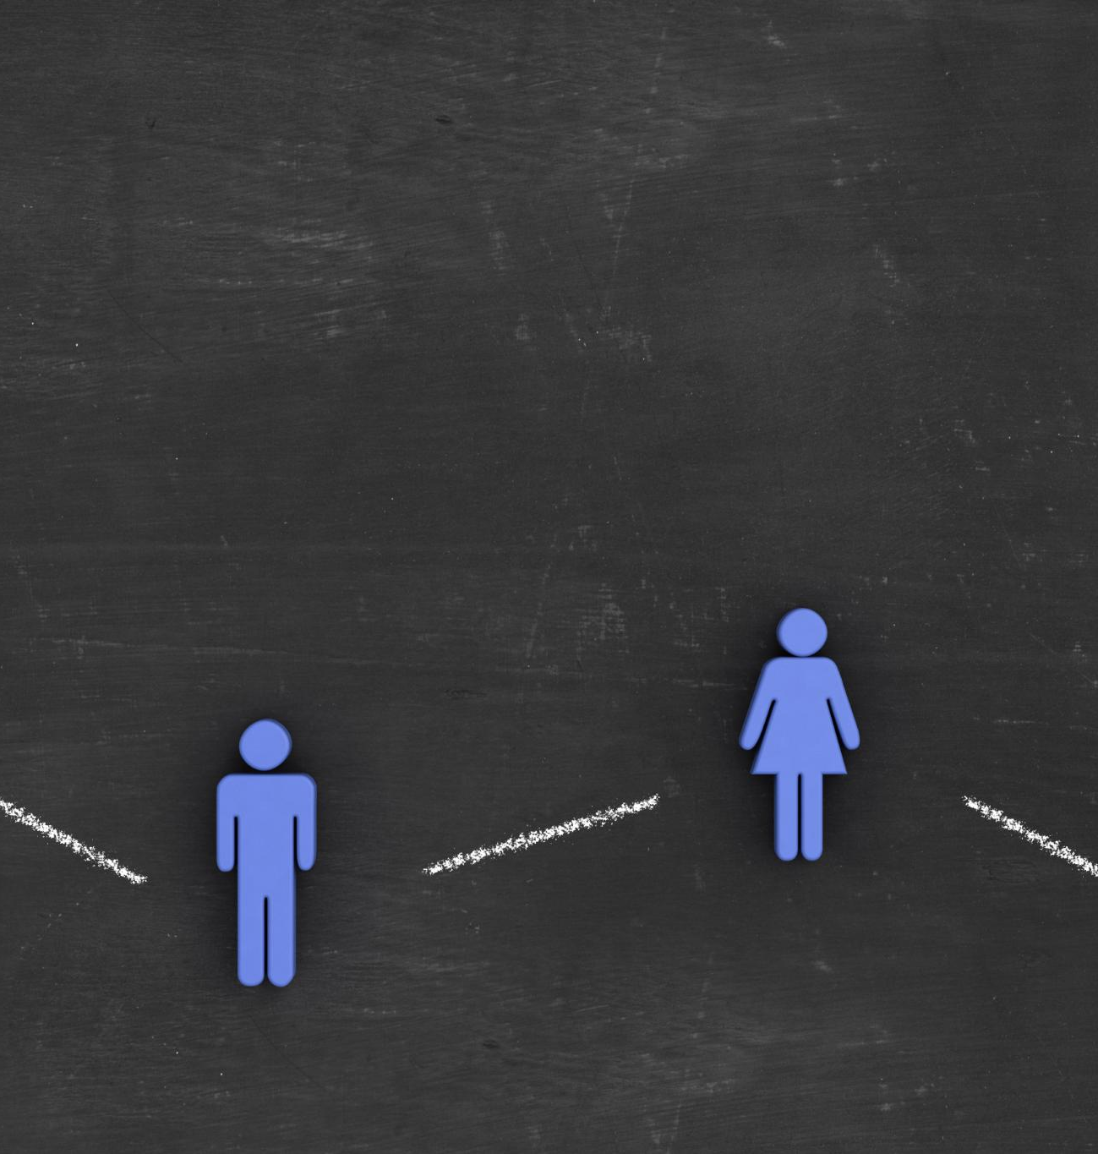
My Life Chapters
Organizing Personal History
  Dividing life into chapters helps adolescents organize personal history into a clear and coherent timeline.
Supporting Identity Development
  Reflecting on life chapters encourages identity development and self-understanding among adolescents.
Managing Complex Experiences
  Using chapters provides a framework to discuss complex or traumatic experiences in a manageable way.
Notes:
Adolescents are guided to divide their life into chapters, assigning titles and themes to each. This activity helps organize their personal history into a coherent timeline, making it easier to understand and reflect upon. It supports identity development and provides a framework for discussing complex or traumatic experiences in a manageable way.

Slide 12
My Turning Points
Significant Life Events
Turning points are key moments that deeply impact an adolescent’s life and shape their future decisions.
Emotional and Cognitive Impact
Reflecting on turning points helps understand changes in thoughts and feelings during adolescence.
Growth and Resilience
Recognizing turning points fosters personal growth and builds resilience and a sense of agency.
Notes:
This slide focuses on pivotal moments that significantly impacted the adolescent’s life. Prompts encourage reflection on how these events influenced their thoughts, feelings, and decisions. Identifying turning points helps young people recognize growth and change, fostering a sense of agency and resilience.

Slide 13
Relationships and Support
Notes:
My Support Network, My Support Plan

Slide 14

My Support Network
Identifying Support System
  Adolescents learn to identify key people like family, friends, carers, and professionals in their support network.
Circle of Trust Activity
  Drawing a circle of trust helps youth visualize their closest trusted relationships and feel a sense of belonging.
Empowerment through Awareness
  Understanding their support network empowers adolescents to seek help and value healthy relationships.
Notes:
This section helps adolescents identify and map their support system, including family members, friends, carers, and professionals. Activities such as drawing a circle of trust or listing key individuals promote a sense of belonging and safety. Understanding their support network empowers young people to seek help when needed and reinforces the importance of healthy relationships.

Slide 15

My Support Plan
Identifying Support Needs
  Adolescents assess their current and future support requirements to effectively address life challenges.
Resource Identification
  Recognizing available resources and strategies helps youths manage challenges proactively.
Fostering Self-Advocacy
  Developing a support plan builds confidence and empowers adolescents to advocate for themselves.
Notes:
Adolescents are encouraged to outline their current and future support needs. This proactive approach helps them identify resources and strategies for managing challenges. Creating a support plan fosters self-advocacy and ensures that young people feel prepared and supported as they navigate adolescence and beyond.

Slide 16
Daily Life and Personal Interests
Notes:
My Daily Life, My Hobbies & Interests, My School Journey, My Health & Wellbeing

Slide 17

My Daily Life
Typical Daily Activities
  Adolescents reflect on their daily routines to gain insights into their habits and experiences.
Identifying Wellbeing Patterns
  Recognizing patterns in daily life helps understand factors influencing emotional health and behavior.
Promoting Structure and Stability
  Structure and stability in routines support emotional regulation and behavioral control.
Notes:
This slide invites adolescents to describe their typical day, including routines and activities. Understanding daily life provides context for their experiences and helps identify patterns that influence wellbeing. This section supports the development of structure and stability, which are crucial for emotional and behavioural regulation.

Slide 18

My Hobbies & Interests
Exploring Passions
  Engaging in hobbies helps adolescents discover and develop their unique talents and interests.
Building Self-Esteem
  Pursuing individual interests promotes confidence and a positive self-image in young people.
Mental Health Benefits
  Hobbies contribute to improved mental well-being and reduce stress for adolescents.
Social Connections
  Shared interests foster friendships and meaningful social interactions among peers.
Notes:
Adolescents explore their passions and talents through prompts about hobbies and interests. This section celebrates individuality and strengths, promoting positive self-esteem. Engaging in enjoyable activities is also linked to improved mental health and social connection.

Slide 19

My School Journey
Educational Experiences
  The adolescent's journey includes schools attended and memorable educational moments that shaped their growth.
Achievements and Challenges
  Reflecting on school life reveals both accomplishments and obstacles encountered during education.
Learning Style and Aspirations
  Understanding learning styles and future goals helps tailor support for the adolescent's success.
Notes:
This slide focuses on the adolescent’s educational experiences, including schools attended and memorable moments. Reflecting on school life helps identify achievements, challenges, and support needs. It also provides insight into the young person’s learning style and aspirations.

Slide 20
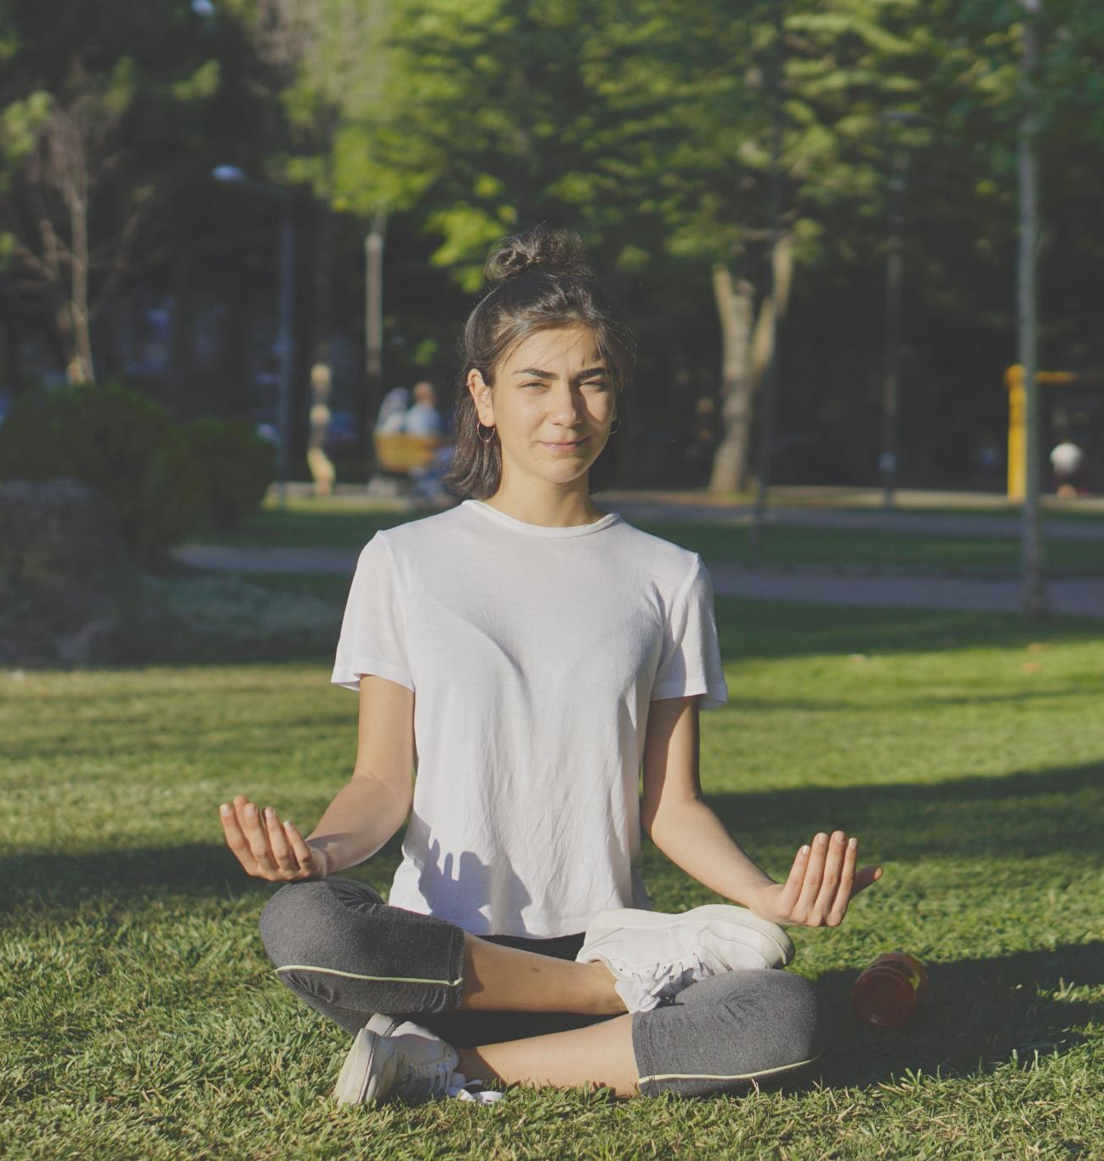
My Health & Wellbeing
Physical and Mental Health Reflection
  Encourages adolescents to think about their physical and mental health, identifying strengths and concerns.
Promoting Self-Care
  Fosters habits of self-care and awareness to support overall wellbeing in young people.
Empowering Health Responsibility
  Empowers youth to take an active role in managing their health and seeking support when needed.
Notes:
Adolescents are prompted to reflect on their physical and mental health, including any concerns or supports. This section encourages self-care and helps identify areas where additional support may be needed. It promotes holistic wellbeing and empowers young people to take an active role in their health.

Slide 21
Values, Culture, and Beliefs
Notes:
My Personal Values, My Cultural Identity, My Spiritual Beliefs

Slide 22
My Personal Values
Identify Core Values
Encouraging adolescents to recognize their core values helps build self-awareness and guides their actions effectively.
Supports Decision-Making
Understanding personal values aids adolescents in making thoughtful and consistent decisions aligned with their beliefs.
Fosters Integrity and Respect
Self-respect and integrity are nurtured through adherence to personal values, essential for healthy personal development.
Notes:
This slide encourages adolescents to identify and reflect on their core values and beliefs. Understanding personal values supports decision-making and goal setting. It also fosters integrity and self-respect, which are essential for healthy development.

Slide 23
My Cultural Identity
Exploring Cultural Background
Adolescents learn about their cultural roots, fostering pride and a stronger sense of identity.
Promoting Heritage Connection
Connecting to cultural heritage helps youth build meaningful links to their community and history.
Understanding Cultural Influence
Recognizing culture’s role shapes adolescents’ perspectives and worldview development.
Notes:
Adolescents explore their cultural background and traditions, promoting pride and connection to heritage. This section supports identity formation and helps young people understand the influence of culture on their experiences and worldview.

Slide 24

My Spiritual Beliefs
Reflection on Beliefs
  Encourages adolescents to think deeply about their spiritual or religious beliefs and personal meaning.
Meaning and Comfort
  Spiritual beliefs provide meaning, comfort, and guidance during life’s challenges.
Notes:
This slide provides space for adolescents to reflect on their spiritual or religious beliefs and how these shape their life. Recognizing spiritual beliefs supports meaning-making and can be a source of comfort and guidance.

Slide 25
Reflection and Future Planning
Notes:
My Wishes for the Future, My Message to Others, Closure & Reflection

Slide 26
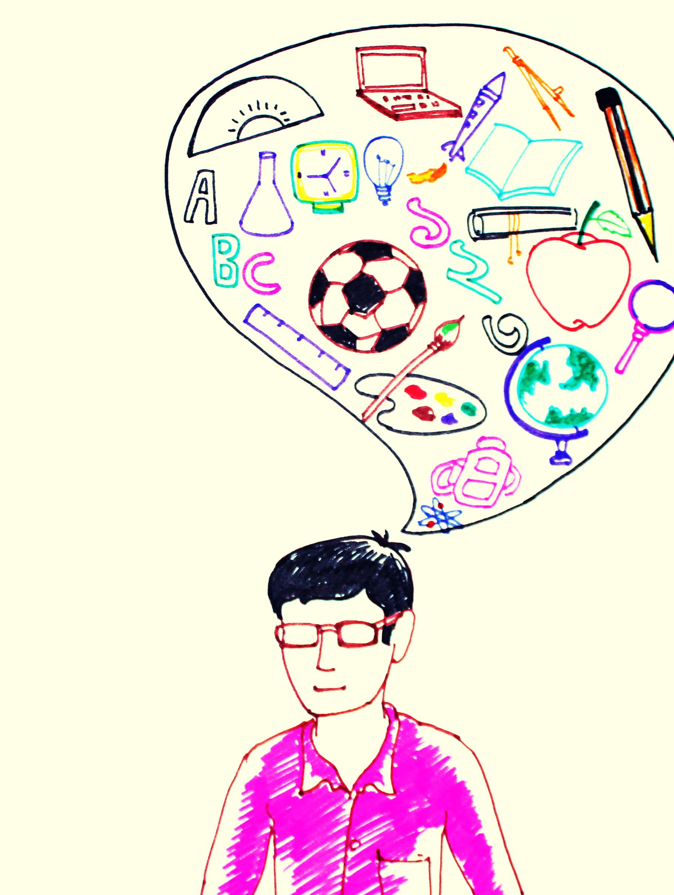
My Wishes for the Future
Personal Aspirations
  Adolescents express their hopes for personal growth, happiness, and meaningful relationships in the future.
Educational Goals
  Many young people set goals for academic achievement and skill development to prepare for future opportunities.
Career Dreams
  Career goals inspire adolescents to pursue professions that match their passions and talents for a fulfilling future.
Notes:
Adolescents articulate their hopes and dreams for the future, including personal, educational, and career goals. This forward-looking section promotes optimism and motivation, helping young people envision a positive path ahead.

Slide 27

My Message to Others
Encouraging Expression
  This slide encourages young people to openly express gratitude, advice, and personal insights to others.
Fostering Connection
  Sharing messages helps foster communication and strengthen connections among peers and loved ones.
Notes:
This slide invites adolescents to share a message with someone important or with others who may read their story. It fosters communication and connection, allowing young people to express gratitude, advice, or personal insights.

