Slide 1

Extended Life Story Work Template for Adolescents (Ages 11–15)
A structured approach to adolescent personal development
Notes:
---

Slide 2
Therapeutic Life Story Work Foundations
Notes:
---
This slide references information from the following file: https://hollymarlow.com/therapeutic-life-story-work/,https://www.communitycare.co.uk/2024/09/24/practice-tips-for-undertaking-life-story-work/
Welcome & Purpose, Creative Identity Mapping

Slide 3

Welcome & Purpose
Emotional Safety and Trust
  Establishing a trusting environment is essential for adolescents to feel safe during therapeutic life story work.
Reflective Storytelling
  Engaging adolescents in reflective storytelling helps them process their past and build self-understanding.
Trauma-Informed Care
  The approach prioritizes trauma-informed care to support emotional regulation and healing in adolescents aged 11 to 15.
Collaborative Healing Journey
  Life story work is a co-created process aimed at helping young people understand their past, present, and future.
Notes:
---
This slide references information from the following file: https://hollymarlow.com/therapeutic-life-story-work/,https://www.communitycare.co.uk/2024/09/24/practice-tips-for-undertaking-life-story-work/
This introductory slide sets the tone for the therapeutic life story work process. It explains the purpose of engaging adolescents in reflective storytelling, emphasizing emotional safety, co-creation, and trauma-informed care. Adolescents aged 11–15 are at a developmental stage where identity formation and emotional regulation are critical. This slide encourages social workers to establish a trusting environment and clarify that the life story work is a collaborative journey aimed at helping the young person understand their past, present, and future. It also introduces the concept of therapeutic storytelling as a tool for healing and self-discovery.

Slide 4
Creative Identity Mapping
Creative Exploration Methods
Using collage, avatar creation, and visual mapping helps adolescents express identity non-verbally and creatively.
Identity Reflection Prompts
Prompts like 'What makes me unique?' encourage deep reflection on personal traits and values.
Therapeutic Self-Expression
This approach supports emotional safety and self-expression, ideal for trauma-affected youth.
Notes:
---
This slide references information from the following file: https://hollymarlow.com/therapeutic-life-story-work/,https://www.communitycare.co.uk/2024/09/24/practice-tips-for-undertaking-life-story-work/
This slide invites adolescents to explore their identity through creative methods such as collage, avatar creation, and visual mapping. These activities allow young people to express who they are in a non-verbal and engaging way, which is particularly helpful for those who have experienced trauma or struggle with verbal communication. The mapping process includes prompts like 'What makes me unique?' and 'What do I value most?' It encourages reflection on personal traits, cultural background, and aspirations. This approach aligns with therapeutic life story work models that prioritize self-expression and emotional safety.

Slide 5
Exploring Memories and Emotions
Notes:
---
This slide references information from the following file: https://creativelifestorywork.com/resources/,https://eu-prod.asyncgw.teams.microsoft.com/v1/objects/0-wuk-d1-c41365eba67c09a41af1946d932e9501/views/original/life_story_template_extended.pptx
Story Fragments & Memory Reconstruction, Jenga of Emotions, Drama & Roleplay

Slide 6

Story Fragments & Memory Reconstruction
Metaphorical Storytelling
  Metaphorical storytelling helps adolescents reconstruct fragmented memories by reflecting on meaningful prompts.
Identity Formation
  Building coherent narratives from memory fragments supports identity formation and emotional healing.
Trauma-Informed Practice
  Using therapeutic metaphors reduces resistance and promotes engagement in a safe narrative space.
Notes:
---
This slide references information from the following file: https://creativelifestorywork.com/resources/,https://eu-prod.asyncgw.teams.microsoft.com/v1/objects/0-wuk-d1-c41365eba67c09a41af1946d932e9501/views/original/life_story_template_extended.pptx
This slide focuses on reconstructing fragmented memories using metaphorical storytelling. Adolescents are encouraged to reflect on past experiences through prompts such as 'A time I felt brave' or 'A place I remember.' These fragments help build a coherent narrative that supports identity formation and emotional healing. The use of therapeutic metaphors allows young people to process difficult emotions indirectly, reducing resistance and promoting engagement. This method is grounded in trauma-informed practices and supports the development of a safe narrative space.

Slide 7

Jenga of Emotions
Emotional Expression Through Play
  The Jenga game uses emotion-labeled blocks to encourage articulation of feelings in a playful environment.
Supporting Emotional Literacy
  This activity fosters emotional literacy and regulation, essential for adolescent trauma recovery.
Adaptability for Various Settings
  Jenga of Emotions can be adapted for both individual reflection and group discussions.
Notes:
---
This slide references information from the following file: https://creativelifestorywork.com/resources/,https://eu-prod.asyncgw.teams.microsoft.com/v1/objects/0-wuk-d1-c41365eba67c09a41af1946d932e9501/views/original/life_story_template_extended.pptx
This interactive slide introduces the 'Jenga of Emotions' activity, where each block is labeled with an emotion or reflective question. As adolescents play, they are prompted to discuss feelings such as sadness, joy, anger, or fear. This playful yet structured approach helps young people articulate complex emotions in a safe and engaging way. It also supports emotional literacy and regulation, which are essential for trauma recovery. The activity is adaptable and can be used in both individual and group settings.

Slide 8

Drama & Roleplay
Exploring Perspectives
  Roleplay uses props and scripts to help adolescents understand different viewpoints and possible outcomes.
Emotional Expression
  Drama provides a safe space for emotional release, especially for those with difficulty expressing verbally.
Building Skills and Resilience
  Roleplay enhances problem-solving, empathy, and resilience in adolescents through creative engagement.
Notes:
---
This slide references information from the following file: https://creativelifestorywork.com/resources/,https://eu-prod.asyncgw.teams.microsoft.com/v1/objects/0-wuk-d1-c41365eba67c09a41af1946d932e9501/views/original/life_story_template_extended.pptx
This slide encourages the use of drama and roleplay to reenact key life events. Adolescents can use props, puppets, or scripts to explore different perspectives and outcomes. This method helps them process past experiences, build empathy, and develop problem-solving skills. Roleplay also allows for emotional release and can be particularly effective for those who struggle with verbal expression. It aligns with therapeutic life story work principles and supports resilience-building through creative engagement.

Slide 9
Building Support and Resilience
Notes:
---
This slide references information from the following file: https://www.socialworkers.org/Practice/NASW-Practice-Standards-Guidelines/NASW-Standards-for-the-Practice-of-Social-Work-with-Adolescents,https://www.researchinpractice.org.uk/children/publications/2022/december/life-story-work-practice-tool-2022/
My Support Network, Mindfulness & Resilience, My Coping Strategies

Slide 10
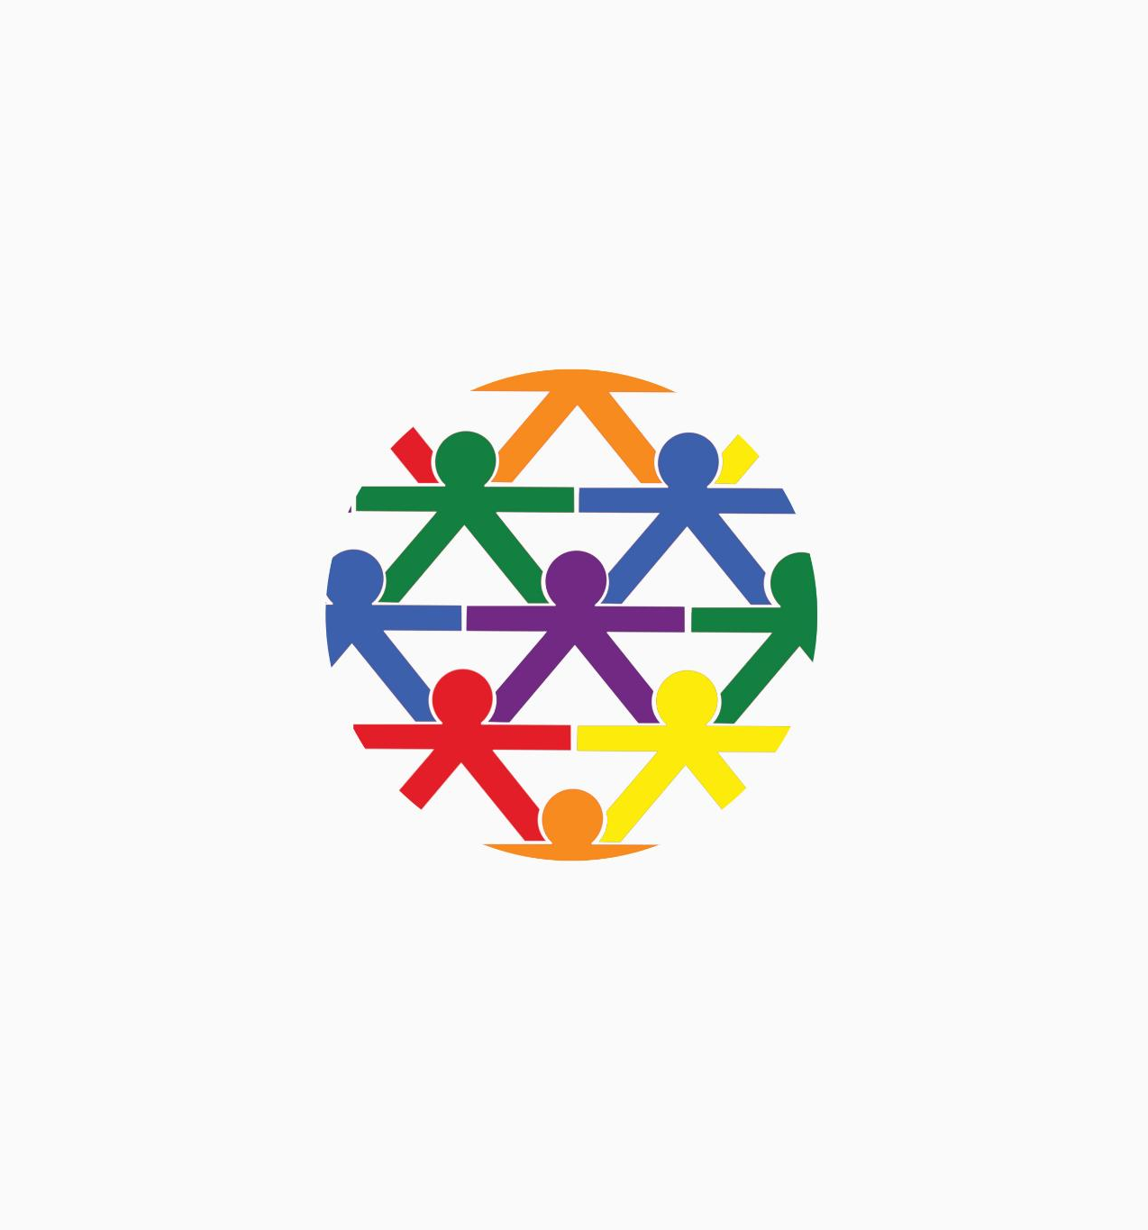
My Support Network
Mapping Support Networks
  Adolescents map their support network using diagrams or circles of trust to identify key people in their lives.
Fostering Belonging
  Recognizing supportive relationships helps young people develop a strong sense of belonging and emotional security.
Insight for Social Workers
  Social workers gain valuable insights into adolescents’ social world to plan appropriate interventions and support.
Notes:
---
This slide references information from the following file: https://www.socialworkers.org/Practice/NASW-Practice-Standards-Guidelines/NASW-Standards-for-the-Practice-of-Social-Work-with-Adolescents,https://www.researchinpractice.org.uk/children/publications/2022/december/life-story-work-practice-tool-2022/
This slide guides adolescents in mapping their support network, including carers, friends, pets, and professionals. Using diagrams or circles of trust, young people identify who they can rely on and what roles these individuals play in their lives. This activity fosters a sense of belonging and helps adolescents recognize the importance of supportive relationships. It also provides social workers with insights into the young person's relational world, which is crucial for planning interventions and support.

Slide 11

Mindfulness & Resilience
Mindfulness Techniques
  Breathing exercises, grounding strategies, and positive affirmations help adolescents reduce stress and improve focus.
Emotional Regulation
  Mindfulness supports self-awareness and emotional regulation, essential for personal growth and trauma healing.
Resilience Building
  Resilience techniques foster coping skills, helping adolescents manage challenges and recover from trauma.
Notes:
---
This slide references information from the following file: https://www.socialworkers.org/Practice/NASW-Practice-Standards-Guidelines/NASW-Standards-for-the-Practice-of-Social-Work-with-Adolescents,https://www.researchinpractice.org.uk/children/publications/2022/december/life-story-work-practice-tool-2022/
This slide introduces mindfulness and resilience-building techniques such as breathing exercises, grounding strategies, and positive affirmations. These practices help adolescents manage stress, regulate emotions, and build coping skills. The slide includes trauma-informed worksheets and encourages daily practice. Mindfulness supports self-awareness and emotional regulation, which are essential for healing and personal growth. This approach is backed by research on trauma recovery and adolescent mental health.

Slide 12

My Coping Strategies
Identifying Coping Methods
  Adolescents reflect on effective coping strategies that help them manage stress and emotions positively.
Promoting Self-Awareness
  This activity fosters self-awareness, encouraging youths to understand their emotional responses and needs.
Building Personalized Toolkits
  Young people build personalized emotional regulation toolkits including music, talking, and physical activity.
Supporting Tailored Interventions
  Social workers use this insight to create tailored support plans to better assist adolescents.
Notes:
---
This slide references information from the following file: https://www.socialworkers.org/Practice/NASW-Practice-Standards-Guidelines/NASW-Standards-for-the-Practice-of-Social-Work-with-Adolescents,https://www.researchinpractice.org.uk/children/publications/2022/december/life-story-work-practice-tool-2022/
This slide helps adolescents identify and reflect on their coping strategies. They explore what helps them feel better during stressful times, such as listening to music, talking to a friend, or engaging in physical activity. The activity promotes self-awareness and empowers young people to build a personalized toolkit for emotional regulation. It also provides social workers with valuable information for tailoring support plans and interventions.

Slide 13
Personal Growth and Future Planning
Notes:
---
This slide references information from the following file: https://ailifestorywork-my.sharepoint.com/personal/pauleyres_ailifestorywork_onmicrosoft_com/_layouts/15/Doc.aspx?sourcedoc=%7B5376A118-3BD2-4E6B-9D55-09966898CB2D%7D&file=life_story_template_v2.pptx&action=edit&mobileredirect=true,https://ailifestorywork-my.sharepoint.com/personal/pauleyres_ailifestorywork_onmicrosoft_com/_layouts/15/Doc.aspx?sourcedoc=%7BB999C5C9-6A85-4B99-A40D-C6E66108A225%7D&file=Life_Story_Work_Template_11_15.pptx&action=edit&mobileredirect=true
Future Vision Board, My Milestones, My Personal Values

Slide 14

Future Vision Board
Creative Vision Board Making
  Adolescents use art and digital tools to visually explore hopes and dreams for their future.
Goal-Setting and Optimism
  The activity promotes optimism and helps develop clear goals essential for motivation and resilience.
Connecting Past and Future
  Participants reflect on past experiences to shape future possibilities, enhancing purpose and agency.
Notes:
---
This slide references information from the following file: https://ailifestorywork-my.sharepoint.com/personal/pauleyres_ailifestorywork_onmicrosoft_com/_layouts/15/Doc.aspx?sourcedoc=%7B5376A118-3BD2-4E6B-9D55-09966898CB2D%7D&file=life_story_template_v2.pptx&action=edit&mobileredirect=true,https://ailifestorywork-my.sharepoint.com/personal/pauleyres_ailifestorywork_onmicrosoft_com/_layouts/15/Doc.aspx?sourcedoc=%7BB999C5C9-6A85-4B99-A40D-C6E66108A225%7D&file=Life_Story_Work_Template_11_15.pptx&action=edit&mobileredirect=true
This slide invites adolescents to create a vision board using magazine cut-outs, drawings, or digital tools. They explore hopes, dreams, and goals for the future, such as career aspirations, travel plans, or personal achievements. This activity fosters optimism and goal-setting, which are important for resilience and motivation. It also helps young people connect their past experiences to future possibilities, reinforcing a sense of agency and purpose.

Slide 15

My Milestones
Reflection on Achievements
  Encourages adolescents to identify and reflect on proud moments and personal accomplishments.
Building Self-Esteem
  Celebrating milestones reinforces self-esteem and resilience among young people.
Supporting Social Workers
  Milestone recognition helps social workers identify strengths for future support planning.
Notes:
---
This slide references information from the following file: https://ailifestorywork-my.sharepoint.com/personal/pauleyres_ailifestorywork_onmicrosoft_com/_layouts/15/Doc.aspx?sourcedoc=%7B5376A118-3BD2-4E6B-9D55-09966898CB2D%7D&file=life_story_template_v2.pptx&action=edit&mobileredirect=true,https://ailifestorywork-my.sharepoint.com/personal/pauleyres_ailifestorywork_onmicrosoft_com/_layouts/15/Doc.aspx?sourcedoc=%7BB999C5C9-6A85-4B99-A40D-C6E66108A225%7D&file=Life_Story_Work_Template_11_15.pptx&action=edit&mobileredirect=true
This slide encourages adolescents to reflect on important milestones and achievements. They identify moments they are proud of, such as academic success, personal growth, or overcoming challenges. Celebrating milestones reinforces self-esteem and resilience. It also helps social workers recognize progress and strengths, which can inform future support and planning.

Slide 16
My Personal Values
Exploring Personal Values
Adolescents reflect on what matters most and the principles guiding their decisions to understand themselves better.
Supporting Identity Formation
Understanding values aids identity development and ethical growth during adolescence, shaping personal integrity.
Therapeutic Life Story Work
Engaging in self-reflection through values exploration fosters personal growth and informed decision-making.
Notes:
---
This slide references information from the following file: https://ailifestorywork-my.sharepoint.com/personal/pauleyres_ailifestorywork_onmicrosoft_com/_layouts/15/Doc.aspx?sourcedoc=%7B5376A118-3BD2-4E6B-9D55-09966898CB2D%7D&file=life_story_template_v2.pptx&action=edit&mobileredirect=true,https://ailifestorywork-my.sharepoint.com/personal/pauleyres_ailifestorywork_onmicrosoft_com/_layouts/15/Doc.aspx?sourcedoc=%7BB999C5C9-6A85-4B99-A40D-C6E66108A225%7D&file=Life_Story_Work_Template_11_15.pptx&action=edit&mobileredirect=true
This slide explores the adolescent's personal values and beliefs. Prompts include 'What matters most to me?' and 'What principles guide my decisions?' Understanding values supports identity formation and ethical development. It also helps young people make informed choices and build a sense of integrity. This activity aligns with therapeutic life story work by fostering self-reflection and personal growth.

Slide 17
Closure and Reflection
Notes:
---
This slide references information from the following file: https://www.eccm.org/blog/cognitive-skills-for-each-age-important-milestones,https://ailifestorywork-my.sharepoint.com/personal/pauleyres_ailifestorywork_onmicrosoft_com/_layouts/15/Doc.aspx?sourcedoc=%7BB999C5C9-6A85-4B99-A40D-C6E66108A225%7D&file=Life_Story_Work_Template_11_15.pptx&action=edit&mobileredirect=true
My Safe Spaces, Closure & Reflection

Slide 18

My Safe Spaces
Identifying Safe Spaces
  Adolescents recognize places where they feel secure and emotionally comfortable during stress.
Emotional Comfort Factors
  Reflection on what makes these places comforting helps adolescents manage emotions effectively.
Support for Recovery
  Access to safe spaces aids trauma recovery and supports emotional regulation for young people.
Insight for Social Workers
  Understanding youths' safe spaces provides valuable information for social workers' support strategies.
Notes:
---
This slide references information from the following file: https://www.eccm.org/blog/cognitive-skills-for-each-age-important-milestones,https://ailifestorywork-my.sharepoint.com/personal/pauleyres_ailifestorywork_onmicrosoft_com/_layouts/15/Doc.aspx?sourcedoc=%7BB999C5C9-6A85-4B99-A40D-C6E66108A225%7D&file=Life_Story_Work_Template_11_15.pptx&action=edit&mobileredirect=true
This slide helps adolescents identify places where they feel safe and comfortable. They reflect on what makes these spaces comforting and how they can access them during stressful times. Safe spaces may include a bedroom, a park, or a trusted adult's home. Recognizing and accessing safe spaces supports emotional regulation and trauma recovery. It also provides social workers with insights into the young person's coping environment.

Slide 19

Closure & Reflection
Reflective Writing Activity
  Adolescents write letters to their future selves to summarize their journey and key learnings.
Receiving Affirmations
  Carers and social workers provide affirmations to support emotional healing and growth.
Encouraging Emotional Healing
  Closure activities promote emotional healing and prepare young people for future growth.
Notes:
---
This slide references information from the following file: https://www.eccm.org/blog/cognitive-skills-for-each-age-important-milestones,https://ailifestorywork-my.sharepoint.com/personal/pauleyres_ailifestorywork_onmicrosoft_com/_layouts/15/Doc.aspx?sourcedoc=%7BB999C5C9-6A85-4B99-A40D-C6E66108A225%7D&file=Life_Story_Work_Template_11_15.pptx&action=edit&mobileredirect=true
This final slide invites adolescents to reflect on their life story journey. Activities include writing a letter to their future self, summarizing key learnings, and receiving affirmations from carers or social workers. Closure activities help consolidate insights, promote emotional healing, and prepare young people for future growth. This slide reinforces the therapeutic goals of life story work and celebrates the adolescent's progress.

