Slide 1

Therapeutic and Creative Life Story Work for Adolescents
Empowering youth through expression and personal growth
Notes:
AI-generated content may be incorrect. ---

Slide 2
Foundations of Therapeutic Life Story Work
Notes:
--- This slide references information from the following file: https://www.proceduresonline.com/trixcms1/media/13578/life-story-work-practice-tool.pdf,https://bmjopen.bmj.com/content/bmjopen/13/10/e075093.full.pdf Welcome & Purpose

Slide 3
Welcome & Purpose
Trauma-Informed Approach
TLSW prioritizes emotional safety and relationship-based practice to support adolescent healing.
Identity Formation Support
TLSW helps adolescents integrate personal histories to foster identity and resilience.
Collaborative Storytelling
Young people actively shape their life stories through creative and therapeutic engagement.
Notes:
--- This slide references information from the following file: https://www.proceduresonline.com/trixcms1/media/13578/life-story-work-practice-tool.pdf,https://bmjopen.bmj.com/content/bmjopen/13/10/e075093.full.pdf Therapeutic Life Story Work (TLSW) is a trauma-informed approach designed to help adolescents aged 11–15 understand and integrate their personal histories. This method prioritizes emotional safety, co-creation, and relationship-based practice. The purpose of TLSW is to support identity formation, promote healing, and empower young people to make sense of their past, present, and future. It involves collaborative storytelling, creative expression, and therapeutic engagement, often facilitated by social workers, carers, and therapists. Adolescents are encouraged to take an active role in shaping their narratives, which fosters autonomy and builds resilience. This slide introduces the foundational goals of TLSW and sets the tone for a compassionate and engaging journey through life story exploration.

Slide 4
Creative Exploration of Identity
Notes:
--- This slide references information from the following file: https://creativelifestorywork.com/latest/a-round-up-of-our-most-popular-creative-life-story-work-resources/,https://wearebluecabin.com/project/creative-life-story-work/ Creative Identity Mapping, Story Fragments & Memory Reconstruction

Slide 5

Creative Identity Mapping
Visual Identity Exploration
Adolescents use visual and artistic methods to explore their identity and express complex emotions non-verbally.
Trauma-Sensitive Approach
Creative mapping provides a safe way for trauma-impacted youth to explore feelings and experiences indirectly.
Guided Self-Discovery
Social workers use tools like the 'All About Me' toolkit to help identify values, culture, and unique traits.
Building Self-Awareness
These creative activities foster self-awareness and a coherent sense of self, supporting emotional growth.
Notes:
--- This slide references information from the following file: https://creativelifestorywork.com/latest/a-round-up-of-our-most-popular-creative-life-story-work-resources/,https://wearebluecabin.com/project/creative-life-story-work/ Creative identity mapping allows adolescents to explore the question 'Who am I?' through visual and artistic methods. Techniques such as collage creation, avatar design, and metaphorical art help young people express aspects of their identity that may be difficult to articulate verbally. This approach is particularly effective for trauma-impacted youth, as it provides a safe and indirect way to explore complex emotions and experiences. Social workers can guide adolescents in identifying personal values, cultural background, and unique traits using tools like the 'All About Me' toolkit. These activities foster self-awareness and help build a coherent sense of self, which is essential for emotional development and healing.

Slide 6

Story Fragments & Memory Reconstruction
Fragmented Memories in Adolescence
Adolescents often experience fragmented memories due to trauma or disrupted attachments affecting their life narratives.
Therapeutic Memory Reconstruction
Memory reconstruction techniques use guided prompts to help adolescents revisit and reinterpret their past experiences.
Emotional Validation and Resilience
This process validates emotions, integrates positive memories, and supports emotional resilience and identity development.
Notes:
--- This slide references information from the following file: https://creativelifestorywork.com/latest/a-round-up-of-our-most-popular-creative-life-story-work-resources/,https://wearebluecabin.com/project/creative-life-story-work/ Adolescents often have fragmented memories due to trauma, separation, or disrupted attachments. Story fragments and memory reconstruction techniques help them piece together their life narratives in a meaningful way. Using therapeutic metaphors and guided prompts such as 'A time I felt brave' or 'A place I remember,' social workers can support adolescents in revisiting and reinterpreting past experiences. This process validates their emotions and provides a structured framework for understanding their history. It also allows for the integration of positive memories and reframing of difficult events, contributing to emotional resilience and identity development.

Slide 7
Interactive and Play-Based Techniques
Notes:
--- This slide references information from the following file: https://creativelifestorywork.com/latest/a-round-up-of-our-most-popular-creative-life-story-work-resources/,https://www.solidaritynow.org/wp-content/uploads/2025/02/Manual-Trauma-Informed-Youth-Work_ENGLISH_compressed.pdf Jenga of Emotions, Drama & Roleplay

Slide 8

Jenga of Emotions
Play-Based Emotional Exploration
Using Jenga blocks with emotion prompts makes emotional exploration engaging and non-threatening for adolescents.
Building Emotional Vocabulary
The activity encourages self-expression and helps adolescents expand their emotional vocabulary effectively.
Supporting Emotional Regulation
This method aids social workers in assessing emotional states and coping mechanisms in a supportive way.
Fostering Trust and Rapport
The game format builds trust and strengthens rapport between adolescents and practitioners.
Notes:
--- This slide references information from the following file: https://creativelifestorywork.com/latest/a-round-up-of-our-most-popular-creative-life-story-work-resources/,https://www.solidaritynow.org/wp-content/uploads/2025/02/Manual-Trauma-Informed-Youth-Work_ENGLISH_compressed.pdf The 'Jenga of Emotions' is a play-based technique that uses modified Jenga blocks inscribed with emotion words or reflective questions. This method facilitates emotional exploration in a non-threatening and engaging manner. As adolescents pull blocks, they respond to prompts such as 'Describe a time you felt proud' or 'What makes you feel safe?' This activity encourages self-expression, builds emotional vocabulary, and helps social workers assess emotional states and coping mechanisms. It is particularly effective for adolescents who struggle with verbal communication or emotional regulation. The game format also fosters trust and rapport between the adolescent and the practitioner.

Slide 9
Drama & Roleplay
Therapeutic Re-enactment
Drama enables adolescents to safely re-enact key life events and explore different perspectives for healing.
Emotional Processing and Empathy
Using drama and roleplay supports emotional processing and helps develop empathy and narrative coherence.
Facilitating Insight and Resilience
Drama allows externalizing difficult emotions, fostering insight, identity exploration, and resilience in adolescents.
Notes:
--- This slide references information from the following file: https://creativelifestorywork.com/latest/a-round-up-of-our-most-popular-creative-life-story-work-resources/,https://www.solidaritynow.org/wp-content/uploads/2025/02/Manual-Trauma-Informed-Youth-Work_ENGLISH_compressed.pdf Drama and roleplay are powerful tools in therapeutic life story work, allowing adolescents to re-enact key life events and explore different perspectives. Using props, puppets, or guided scripts, young people can safely revisit past experiences and experiment with alternative outcomes. This method supports emotional processing, empathy development, and narrative coherence. It also enables adolescents to externalize difficult emotions and gain insight into their behaviors and relationships. Social workers can use drama to facilitate discussions about identity, resilience, and future aspirations, making it a versatile and impactful technique in trauma-informed practice.

Slide 10
Low-Intensity and Everyday Life Story Work
Notes:
--- This slide references information from the following file: https://bmjopen.bmj.com/content/bmjopen/13/10/e075093.full.pdf,https://www.numberanalytics.com/blog/effective-life-story-work-practices Low-Intensity Life Story Work, My Support Network

Slide 11

Low-Intensity Life Story Work
Accessible Storytelling Methods
Low-intensity techniques include journaling, photo diaries, voice notes, and casual conversations for easy emotional expression.
Building Safety and Growth
These methods help adolescents build a narrative centered on safety, stability, and personal growth over time.
Person-Centered Collaboration
Social workers co-construct stories with adolescents ensuring developmentally appropriate and person-centered support.
Mental Health Benefits
This approach supports mental health, enhances self-esteem, and prepares for potential intensive therapeutic work.
Notes:
--- This slide references information from the following file: https://bmjopen.bmj.com/content/bmjopen/13/10/e075093.full.pdf,https://www.numberanalytics.com/blog/effective-life-story-work-practices Low-intensity life story work focuses on recording everyday positive events and fostering emotional well-being through accessible methods. This approach is particularly suitable for adolescents who may not be ready for high-intensity therapeutic interventions. Techniques include journaling, photo diaries, voice notes, and casual conversations. These methods help adolescents build a narrative of safety, stability, and growth. Social workers are encouraged to co-construct these stories with the adolescent, ensuring that the process is person-centered and developmentally appropriate. This approach supports mental health, enhances self-esteem, and provides a foundation for more intensive therapeutic work if needed.

Slide 12
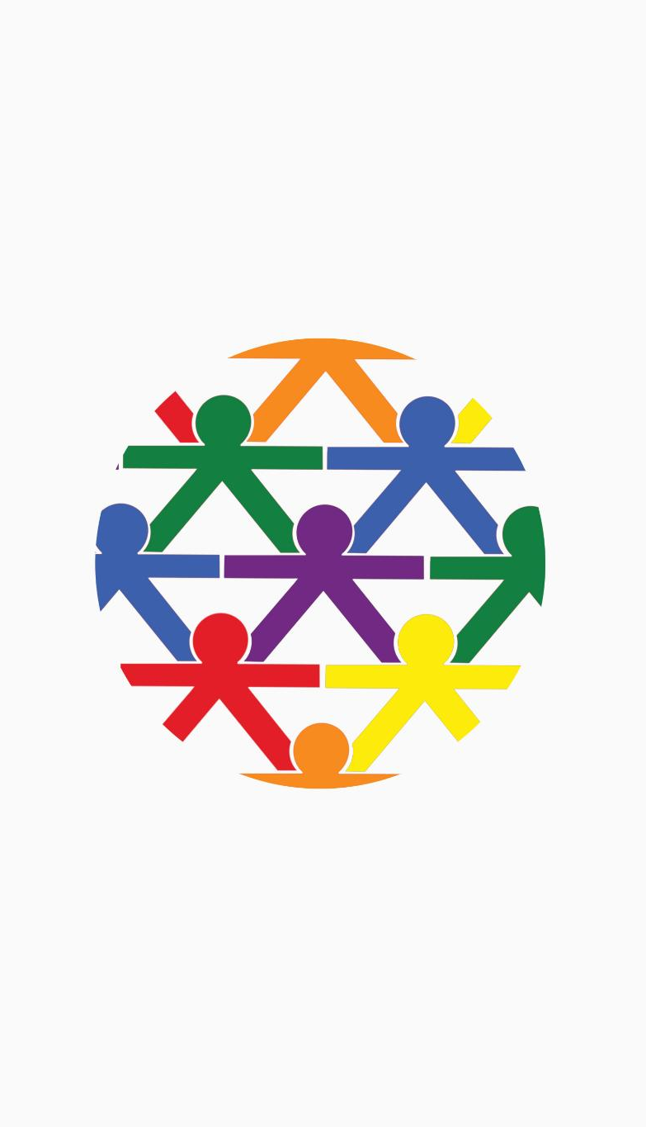
My Support Network
Visualizing Support Networks
Mapping helps adolescents identify key emotional and practical supporters in their lives.
Building Trust and Safety
The 'circle of trust' activity reinforces important relationships providing strength and safety.
Facilitating Communication
Social workers use support maps to discuss trust, boundaries, and effective communication.
Planning for Future Support
Support mapping identifies social gaps and aids in planning ongoing adolescent resilience building.
Notes:
--- This slide references information from the following file: https://bmjopen.bmj.com/content/bmjopen/13/10/e075093.full.pdf,https://www.numberanalytics.com/blog/effective-life-story-work-practices Mapping a support network helps adolescents identify and visualize the people who provide emotional and practical support in their lives. This activity involves creating a 'circle of trust' that includes carers, friends, pets, teachers, and professionals. It reinforces the importance of relationships and helps adolescents recognize their sources of strength and safety. Social workers can use this map to facilitate discussions about trust, boundaries, and communication. It also serves as a tool for planning future support and identifying gaps in the adolescent’s social environment. This activity is essential for building resilience and fostering a sense of belonging.

Slide 13
Resilience and Future Planning
Notes:
--- This slide references information from the following file: http://www.reachfortomorrowohio.org/uploads/7/6/2/8/76281565/trauma-treatment-toolbox-for-teens-144-traumainformed-worksheets-and-exercises-to-promote-resilience-my6ocr_original_.pdf,https://centerforadolescentstudies.com/best-practices-for-working-with-trauma-impacted-youth/ Mindfulness & Resilience, Future Vision Board

Slide 14

Mindfulness & Resilience
Mindfulness Techniques
Techniques like breathing exercises, grounding, and visualizations help adolescents manage stress effectively.
Coping Skill Worksheets
Worksheets from trauma toolkits teach coping skills and promote self-awareness among adolescents.
Resilience Building
Building resilience empowers adolescents to face challenges confidently and maintain emotional balance.
Supportive Environment
Social workers use mindfulness to create calm, supportive environments for trauma-informed sessions.
Notes:
--- This slide references information from the following file: http://www.reachfortomorrowohio.org/uploads/7/6/2/8/76281565/trauma-treatment-toolbox-for-teens-144-traumainformed-worksheets-and-exercises-to-promote-resilience-my6ocr_original_.pdf,https://centerforadolescentstudies.com/best-practices-for-working-with-trauma-impacted-youth/ Mindfulness and resilience-building activities are integral to trauma-informed life story work. Techniques such as breathing exercises, grounding strategies, and guided visualizations help adolescents manage stress and regulate emotions. Worksheets from trauma toolkits can be used to teach coping skills and promote self-awareness. These practices support emotional healing and prepare adolescents to engage more deeply in life story work. Social workers can integrate mindfulness into sessions to create a calm and supportive environment. Building resilience through these methods empowers adolescents to face challenges with confidence and maintain emotional balance.

Slide 15
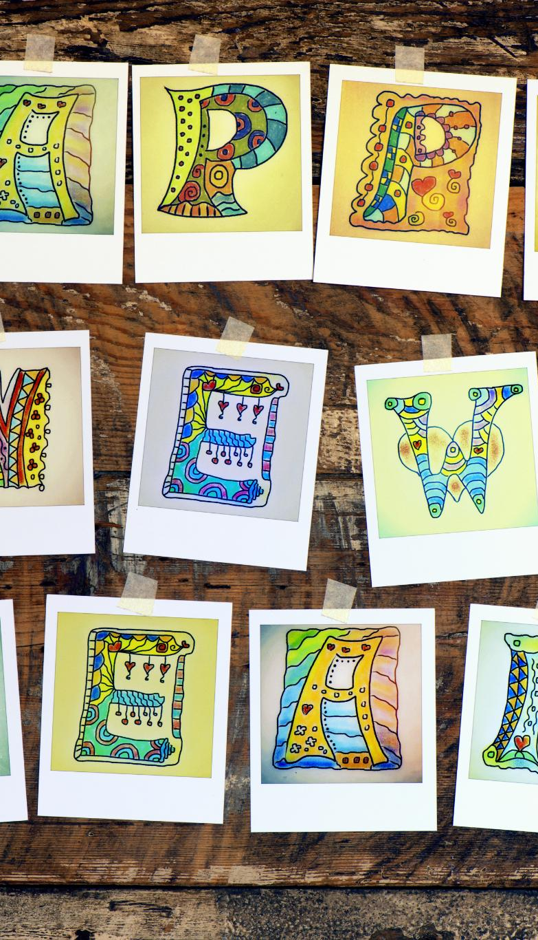
Future Vision Board
Visualizing Aspirations
Vision boards help adolescents visually express their hopes, dreams, and personal values through creative mediums.
Encouraging Forward-Thinking
This activity promotes future-oriented thinking by linking past experiences to upcoming possibilities and opportunities.
Motivational Tool
Vision boards serve as reminders of strengths and potentials, motivating adolescents to pursue their goals actively.
Supporting Goal-Setting
Social workers use vision boards to facilitate discussions and help adolescents plan actionable steps toward their future.
Notes:
--- This slide references information from the following file: http://www.reachfortomorrowohio.org/uploads/7/6/2/8/76281565/trauma-treatment-toolbox-for-teens-144-traumainformed-worksheets-and-exercises-to-promote-resilience-my6ocr_original_.pdf,https://centerforadolescentstudies.com/best-practices-for-working-with-trauma-impacted-youth/ Creating a future vision board allows adolescents to explore their hopes, dreams, and goals through visual representation. Using magazine cut-outs, drawings, or digital tools, they can design a board that reflects their aspirations and values. This activity encourages forward-thinking and helps adolescents connect their past experiences to future possibilities. It also serves as a motivational tool and a reminder of their strengths and potential. Social workers can use the vision board to facilitate goal-setting discussions and support the adolescent in planning actionable steps toward their desired future.

Slide 16
Closure and Reflection
Notes:
--- This slide references information from the following file: https://books.google.com/books/about/Innovative_Therapeutic_Life_Story_Work.html?id=A7AKDgAAQBAJ,https://www.orparc.org/training/therapeutic-life-story-work Closure & Reflection

Slide 17
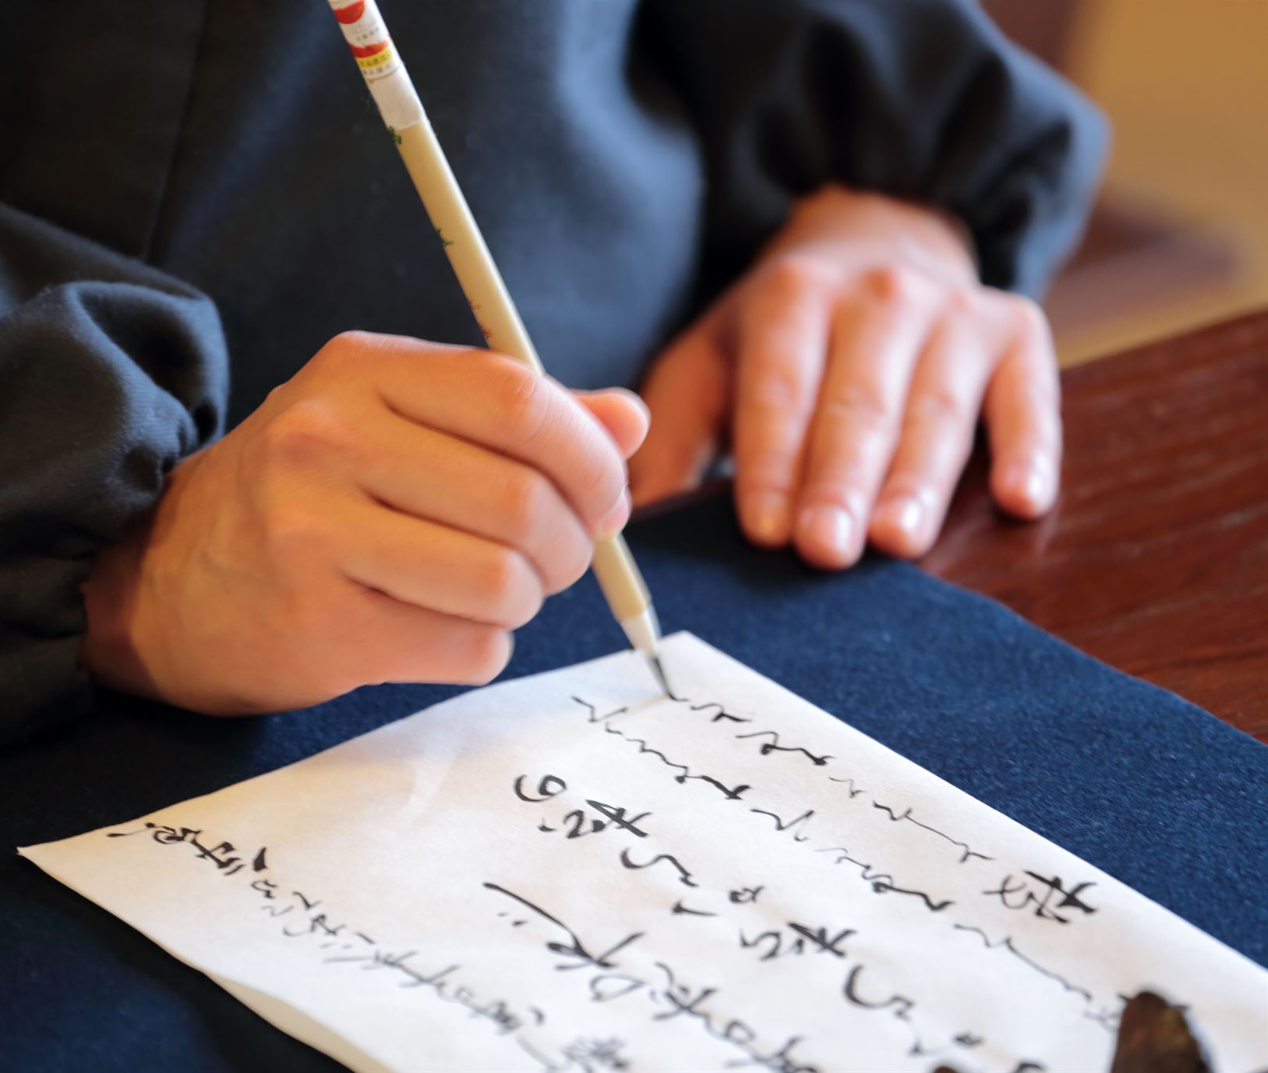
Closure & Reflection
Self-Reflection Through Letter Writing
Writing a letter to the future self helps adolescents reflect on their journey and set aspirations.
Support from Carers and Social Workers
Carers and social workers provide affirmations and support, fostering community and validation.
Emotional Integration and Growth
Closure activities consolidate narratives, celebrate resilience, and prepare for future growth.
Notes:
--- This slide references information from the following file: https://books.google.com/books/about/Innovative_Therapeutic_Life_Story_Work.html?id=A7AKDgAAQBAJ,https://www.orparc.org/training/therapeutic-life-story-work The final stage of life story work involves reflection and closure. Adolescents are invited to write a 'letter to my future self,' summarizing their journey, insights, and aspirations. This activity promotes self-reflection and reinforces the progress made during the life story work process. Carers and social workers can contribute affirmations or messages of support, creating a sense of community and validation. Closure activities help adolescents consolidate their narratives, celebrate their resilience, and prepare for future growth. This stage is essential for emotional integration and marks the transition from exploration to empowerment.

